Slide 1


Slide 2

Thermia Calibra RXT
Product Presentation

Slide 3

Agenda

Slide 4
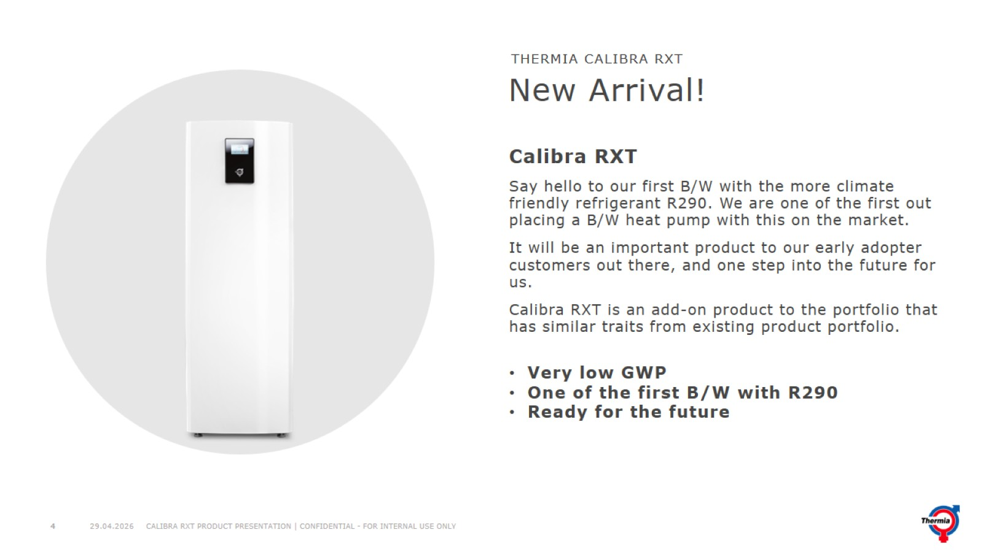
New Arrival!

Slide 5
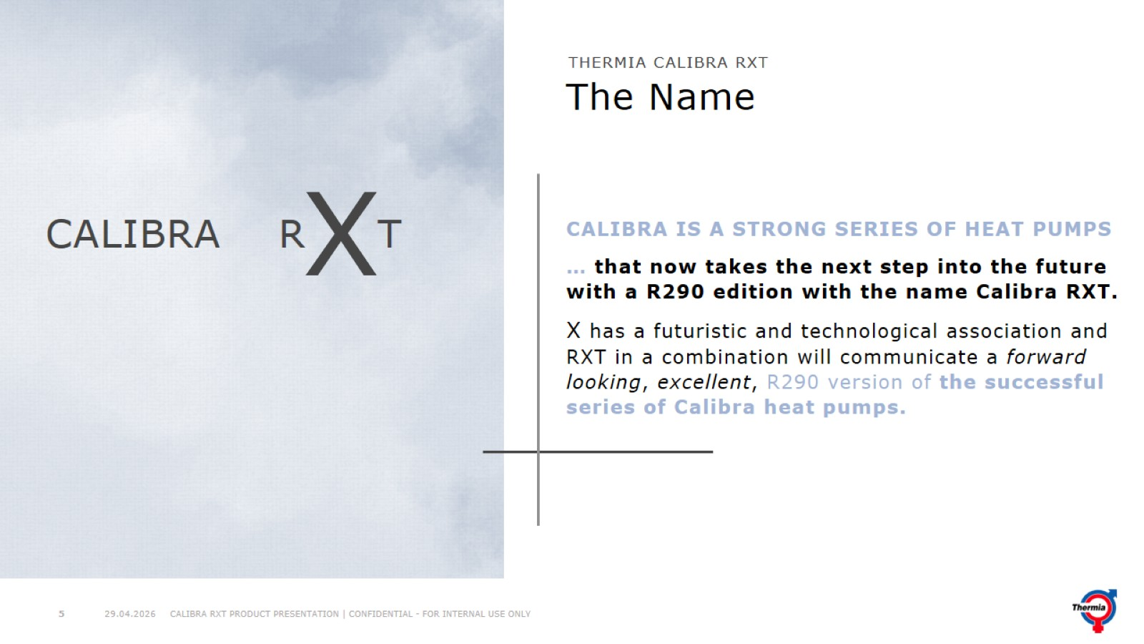
The Name

Slide 6
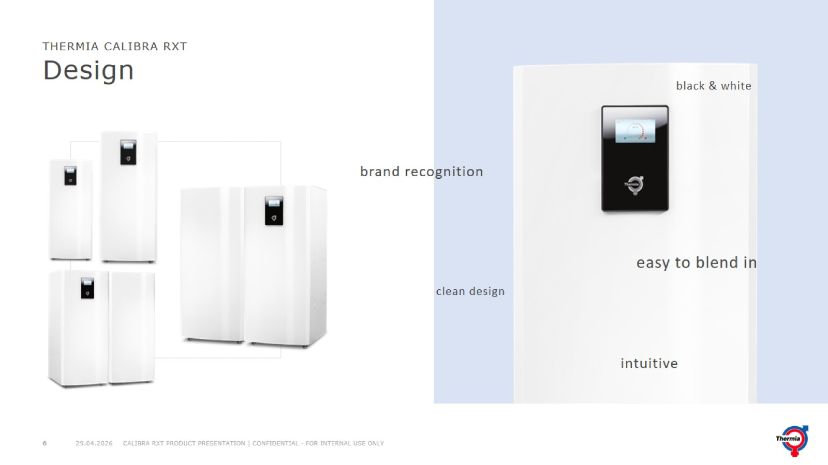
Design

Slide 7
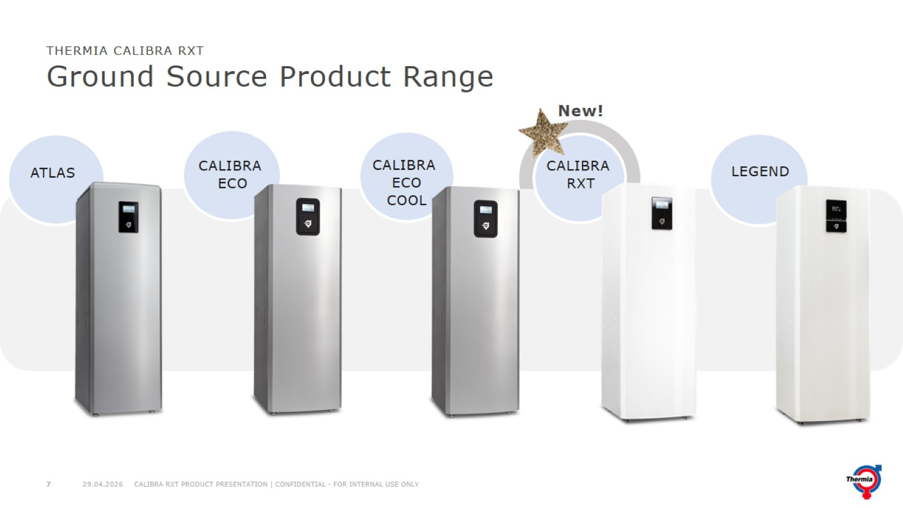
Ground Source Product Range

Slide 8
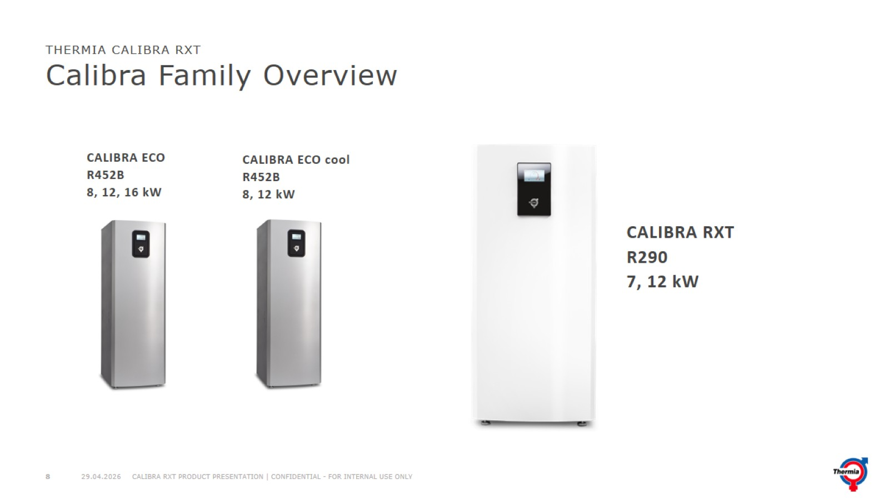
Calibra Family Overview

Slide 9
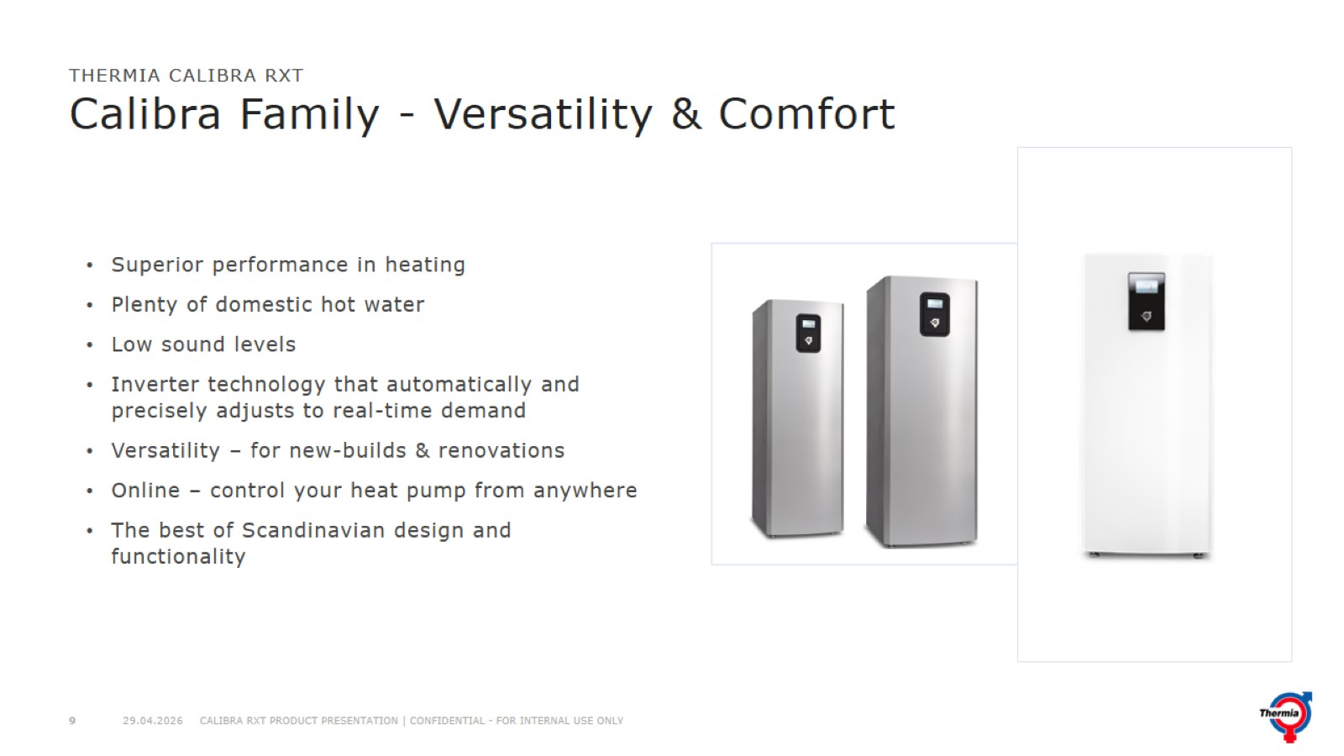
Calibra Family - Versatility & Comfort

Slide 10
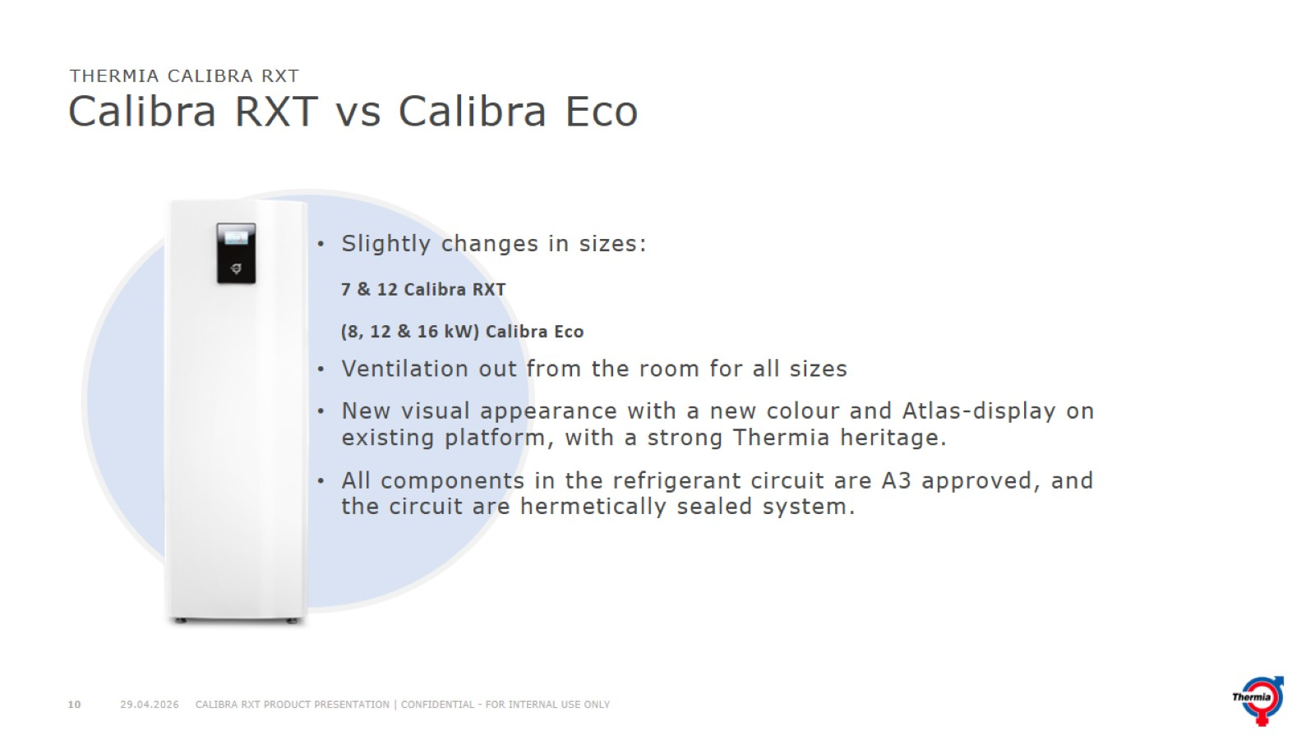
Calibra RXT vs Calibra Eco

Slide 11
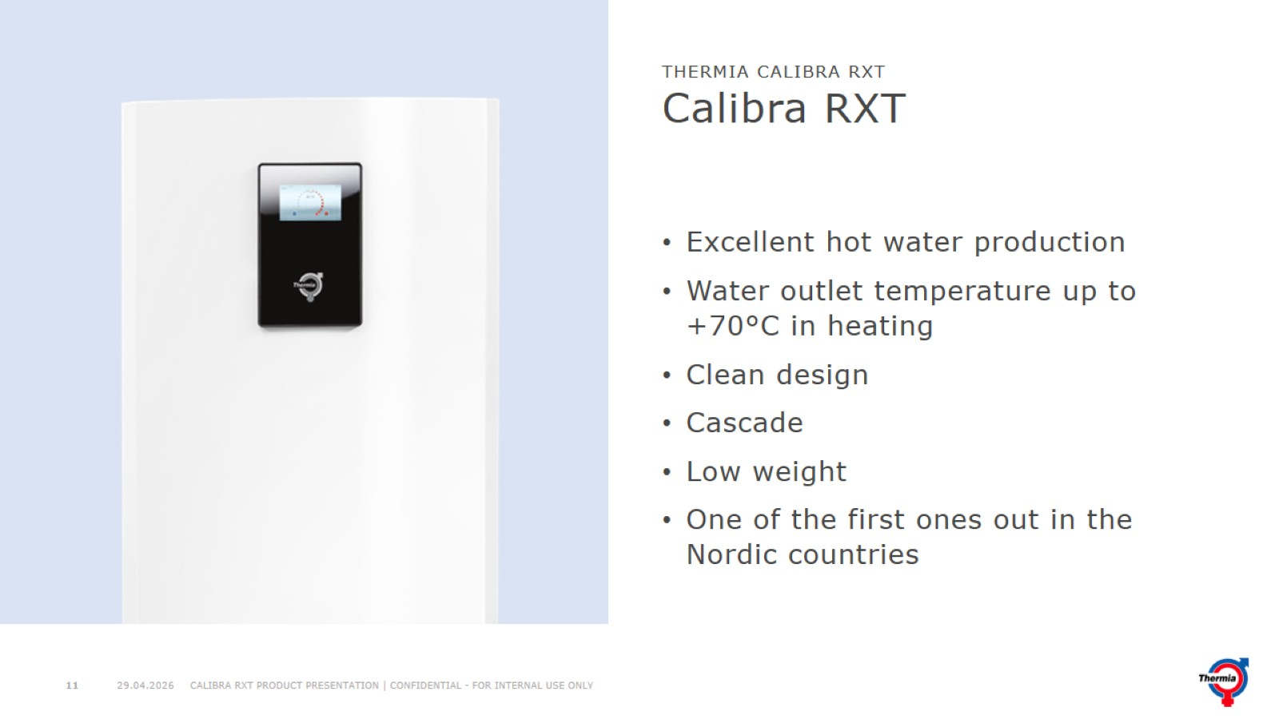
Calibra RXT

Slide 12
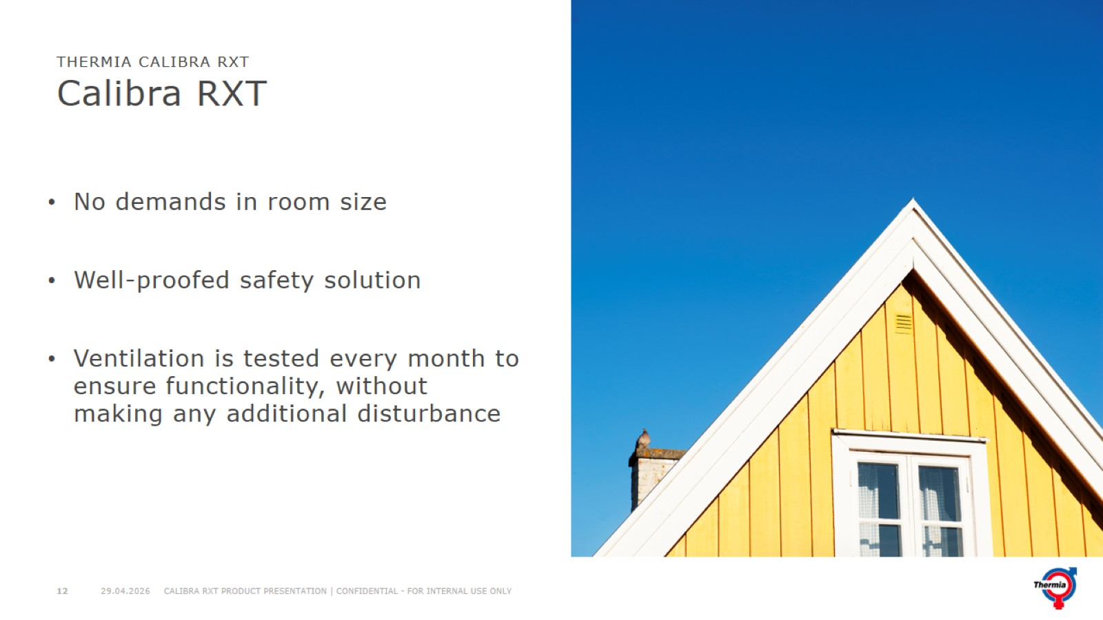
Calibra RXT

Slide 13
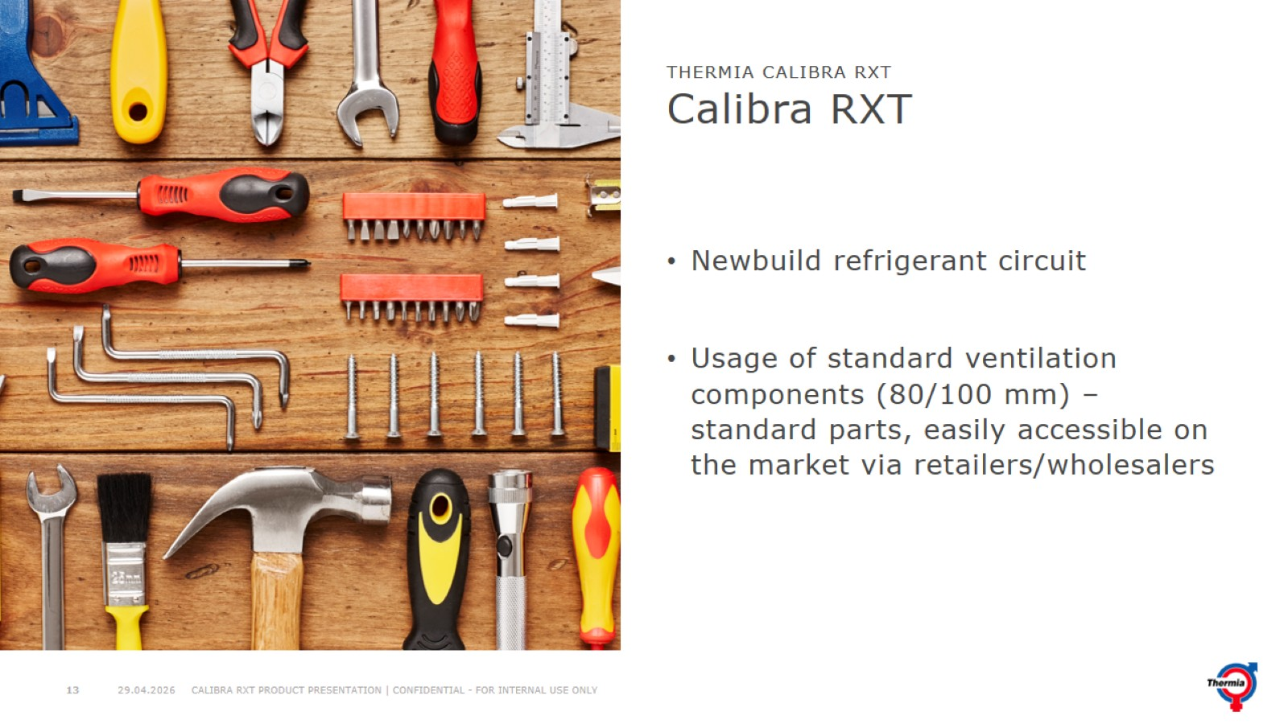
Calibra RXT

Slide 14
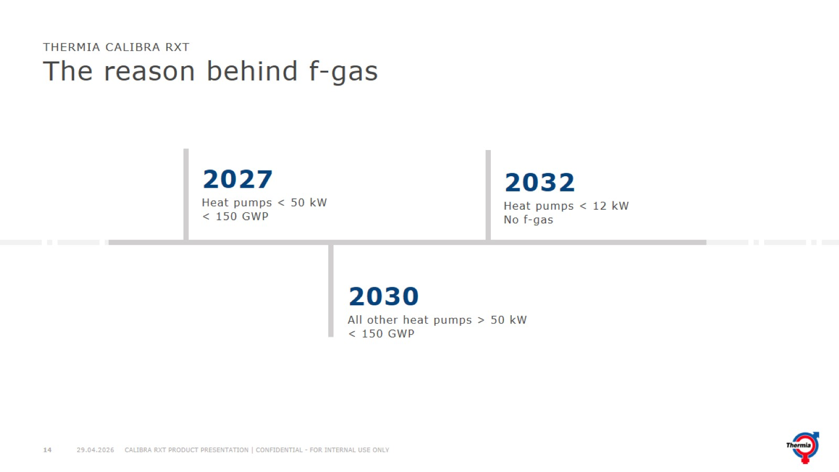
The reason behind f-gas

Slide 15
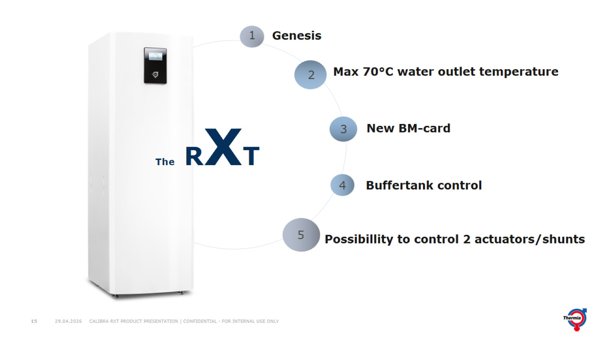

Slide 16
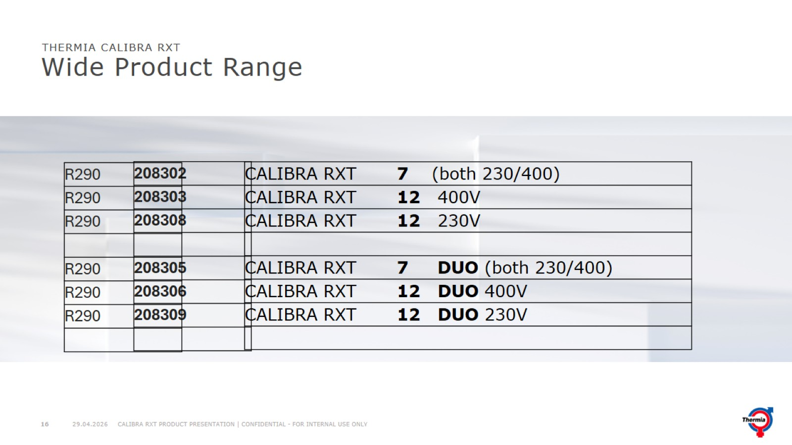
Wide Product Range

Slide 17
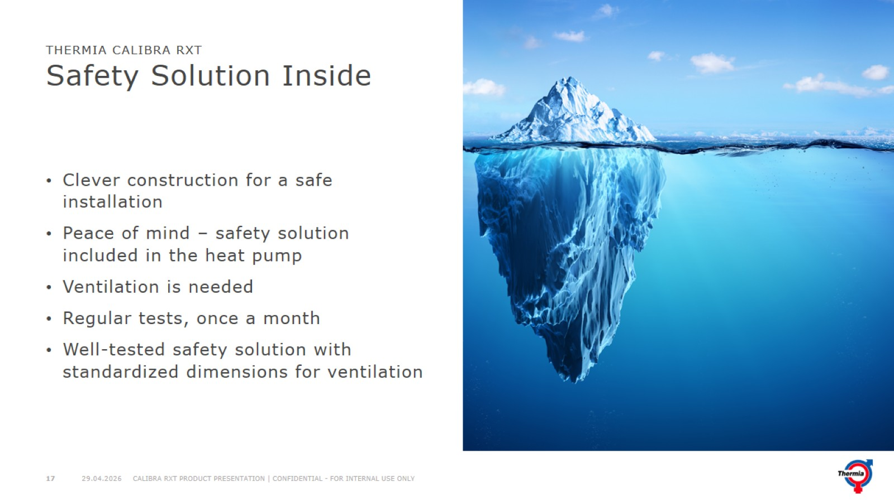
Safety Solution Inside

Slide 18
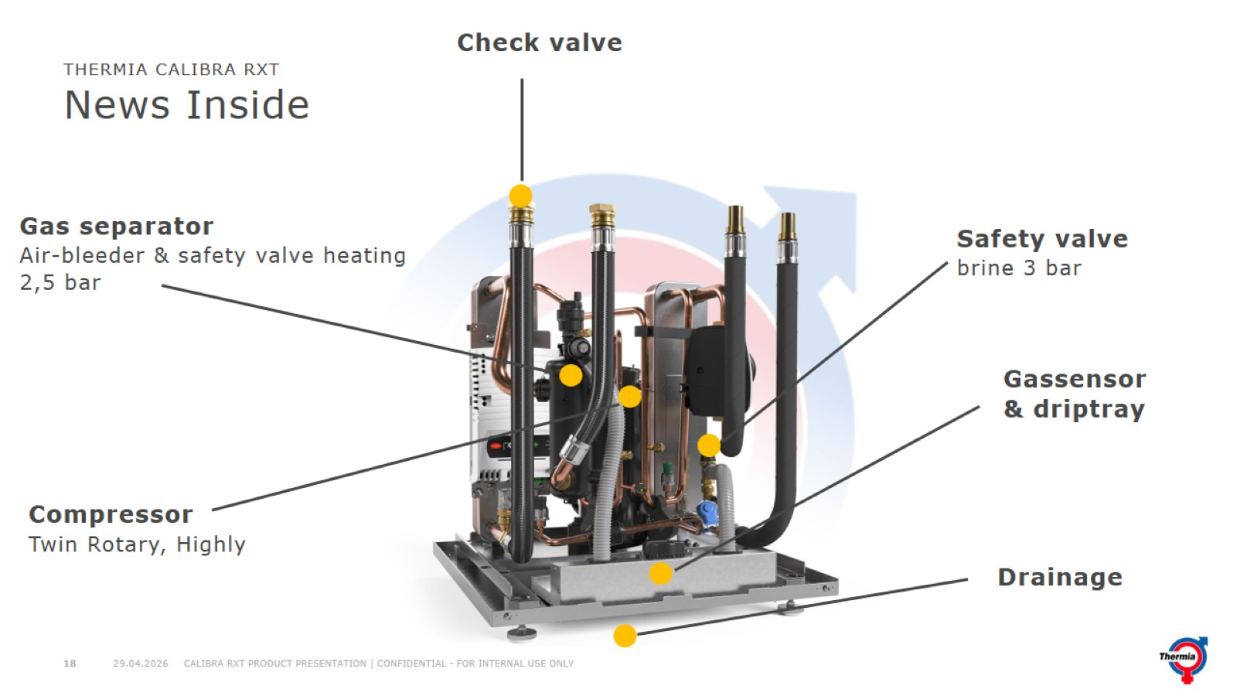
News Inside

Slide 19
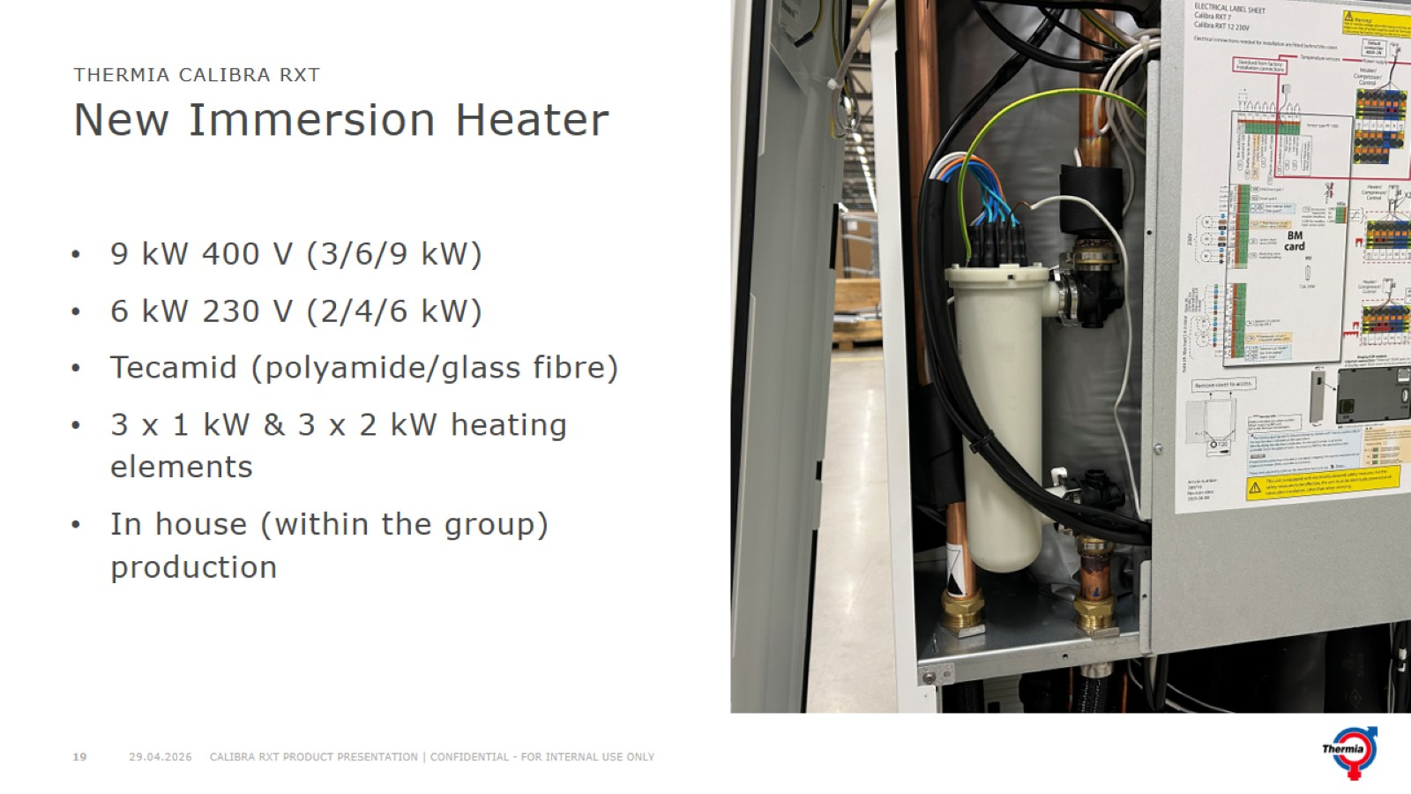
New Immersion Heater

Slide 20
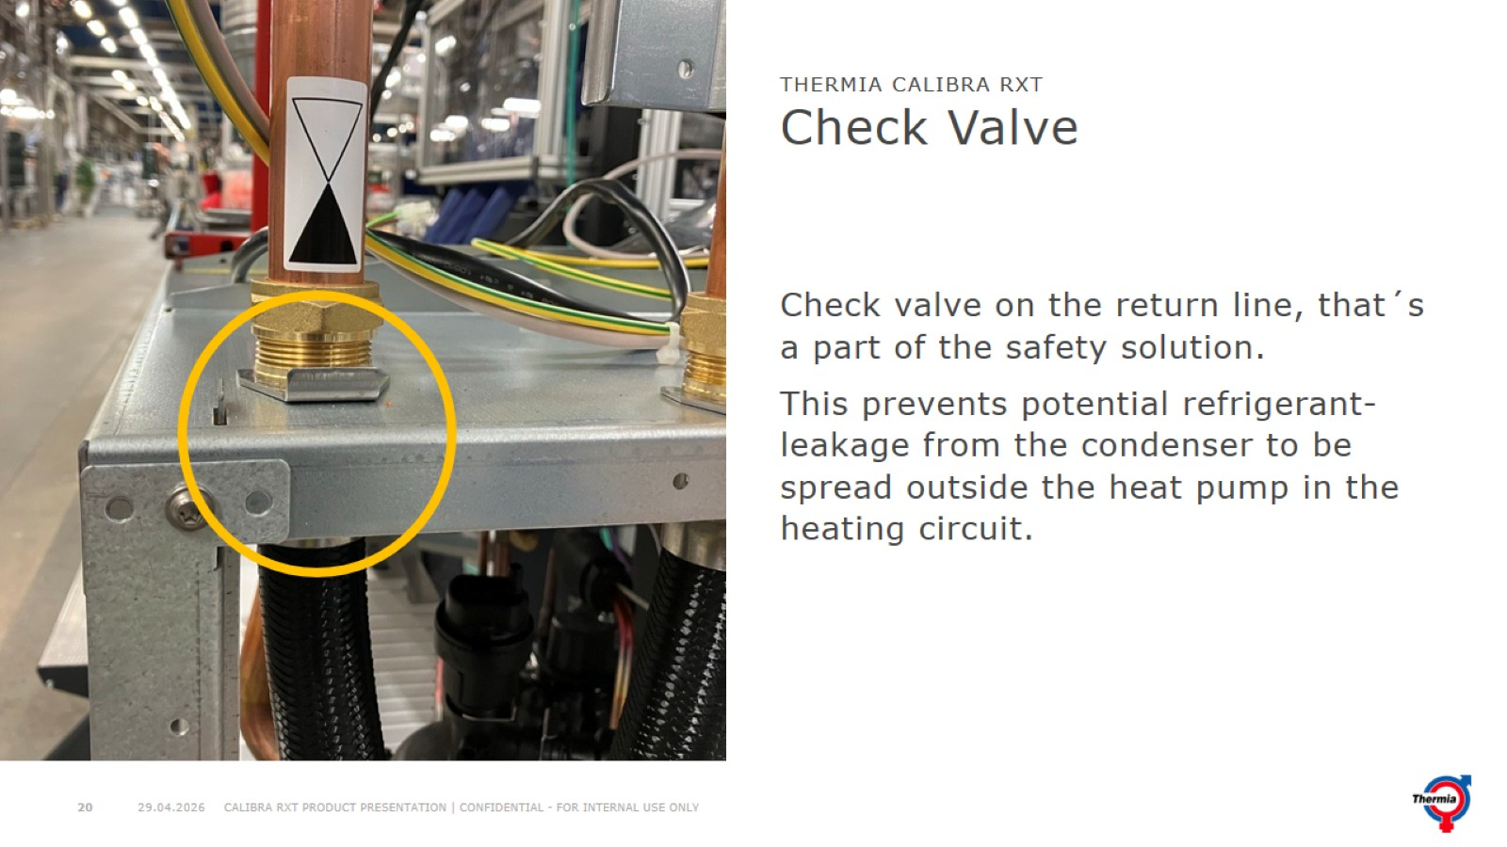
Check Valve

Slide 21
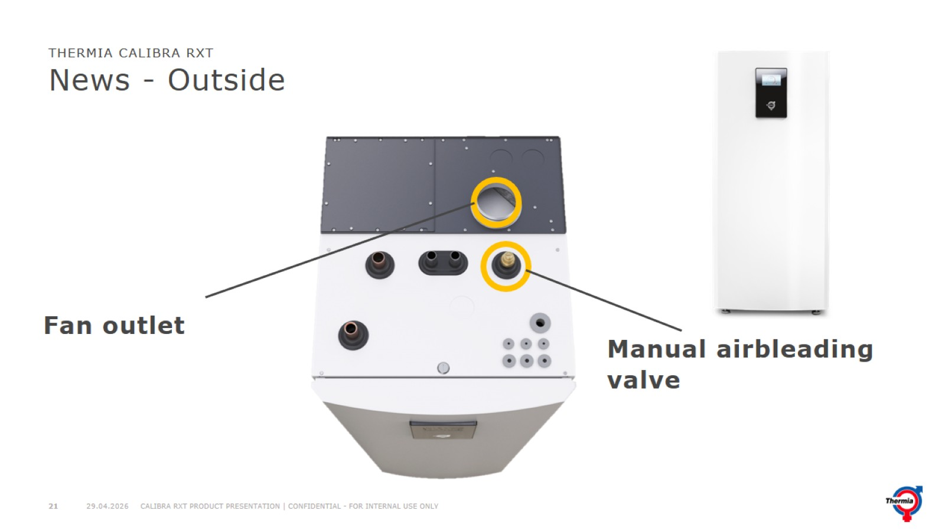
News - Outside

Slide 22
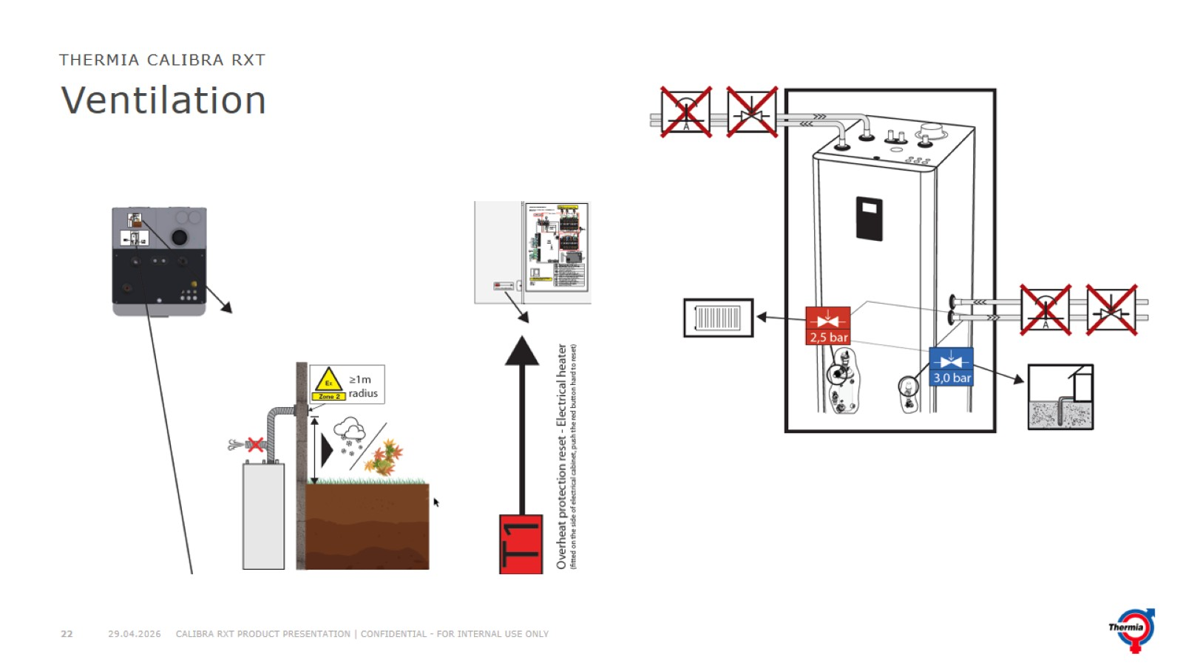
Ventilation

Slide 23
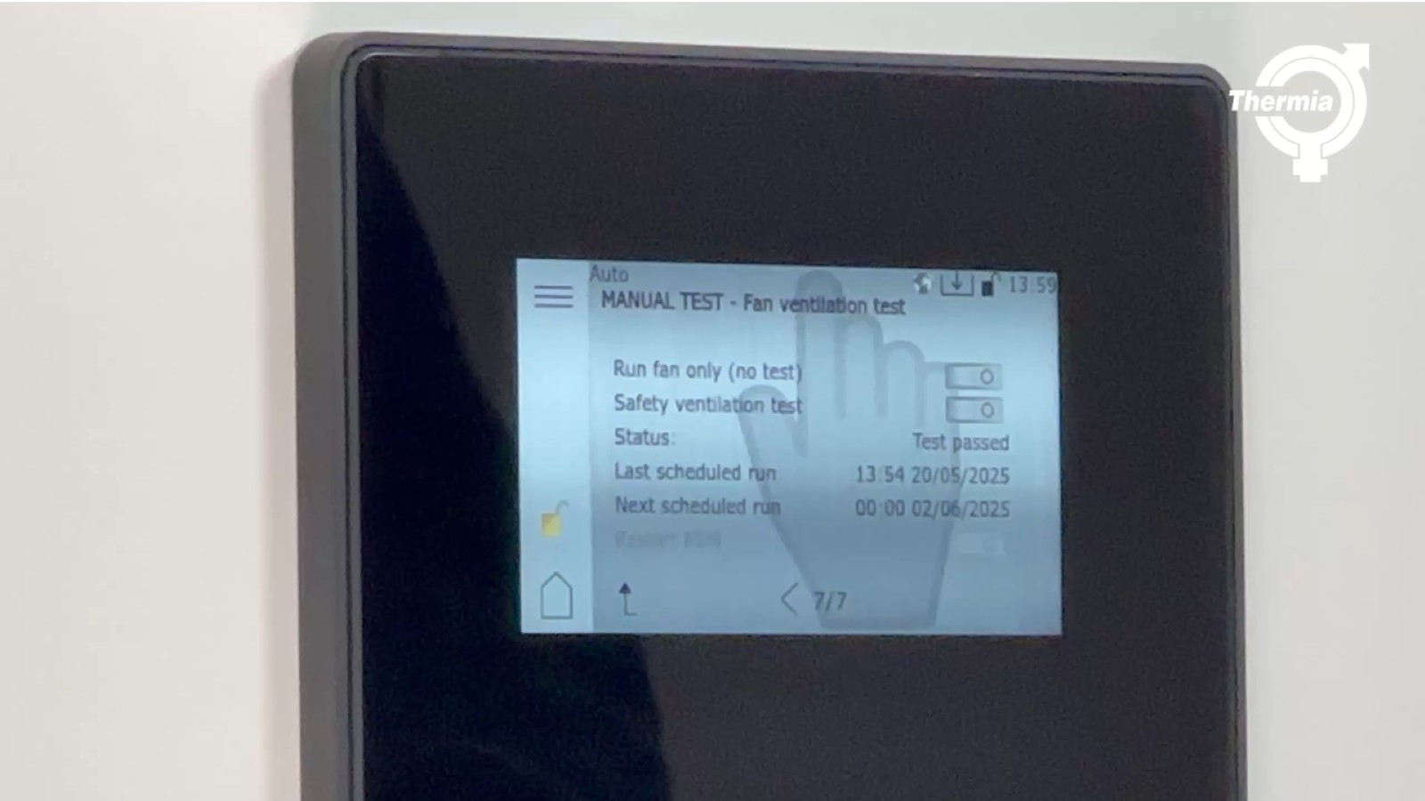

Slide 24
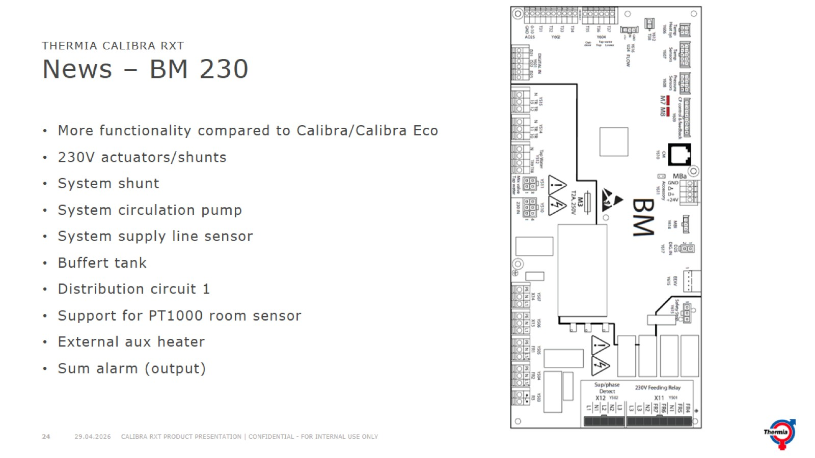
News – BM 230

Slide 25
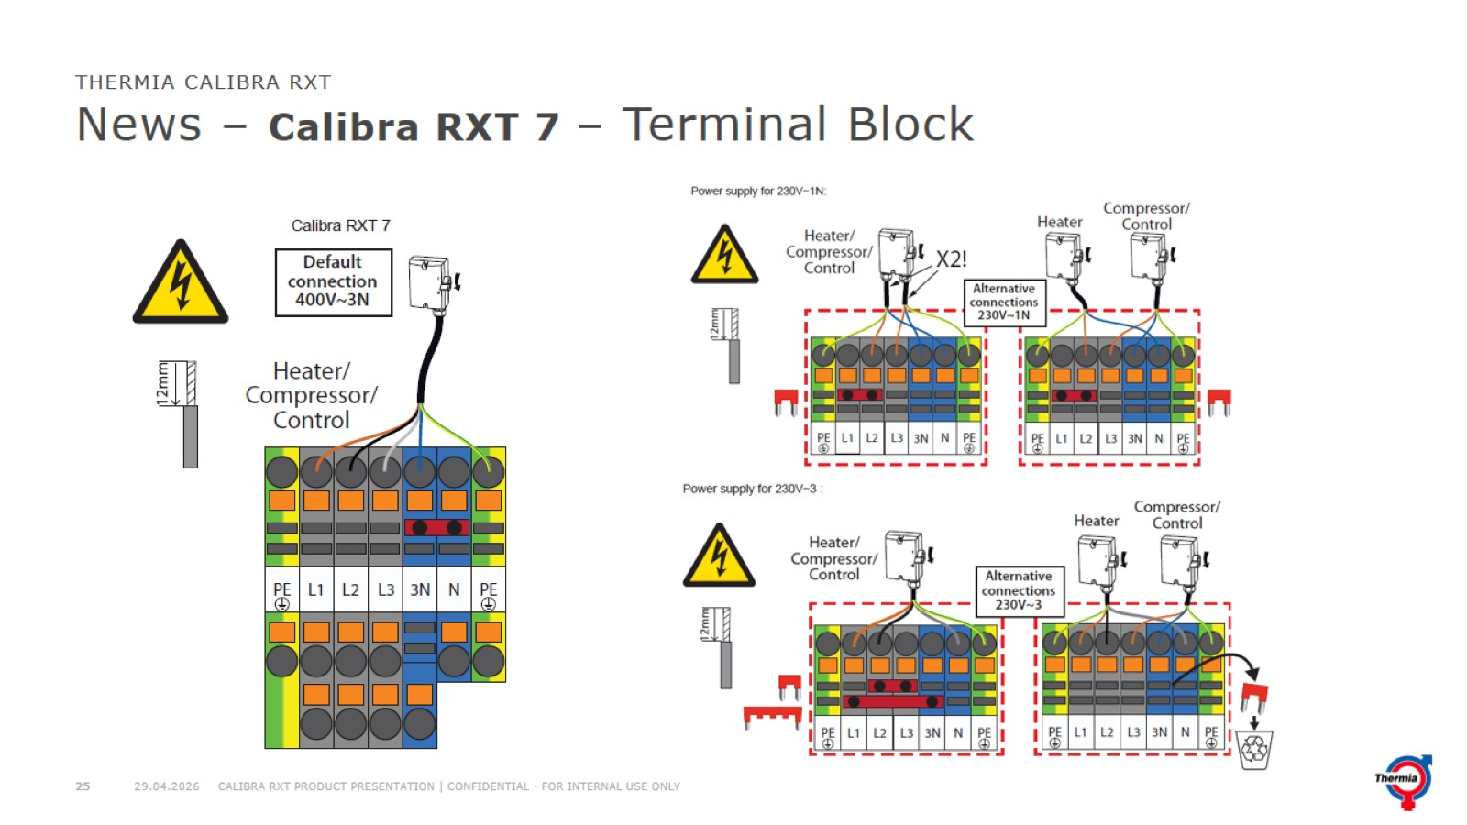
News – Calibra RXT 7 – Terminal Block

Slide 26
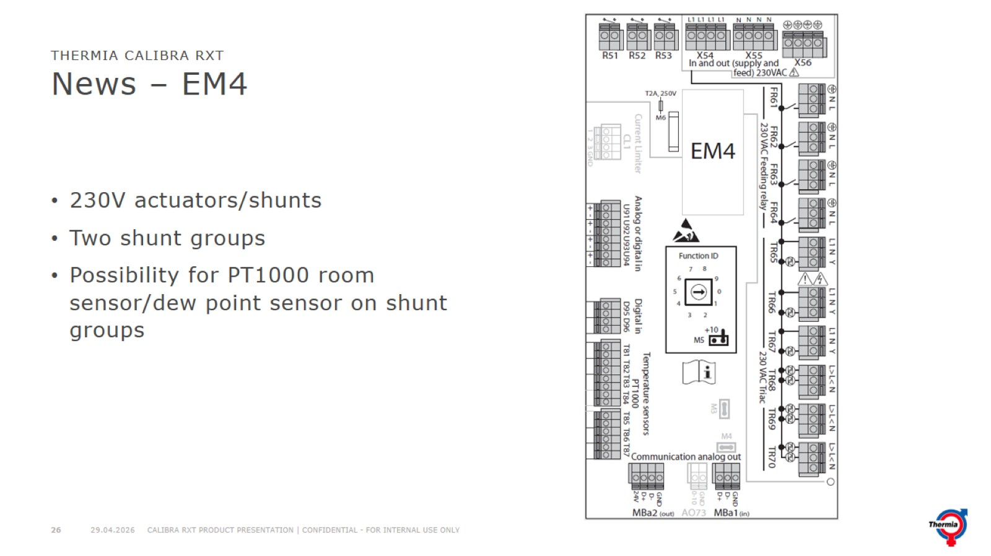
News – EM4

Slide 27
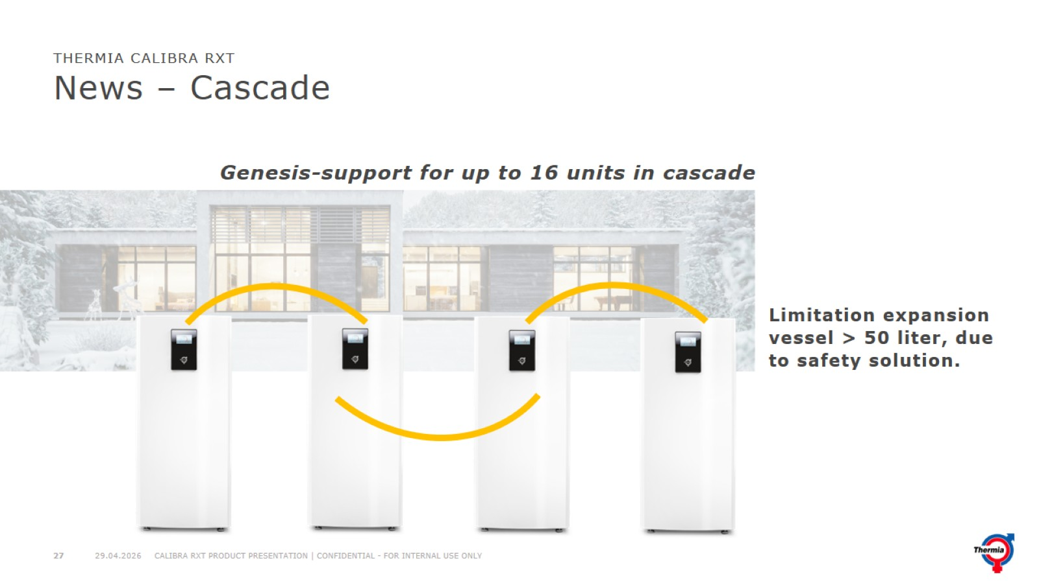
News – Cascade

Slide 28
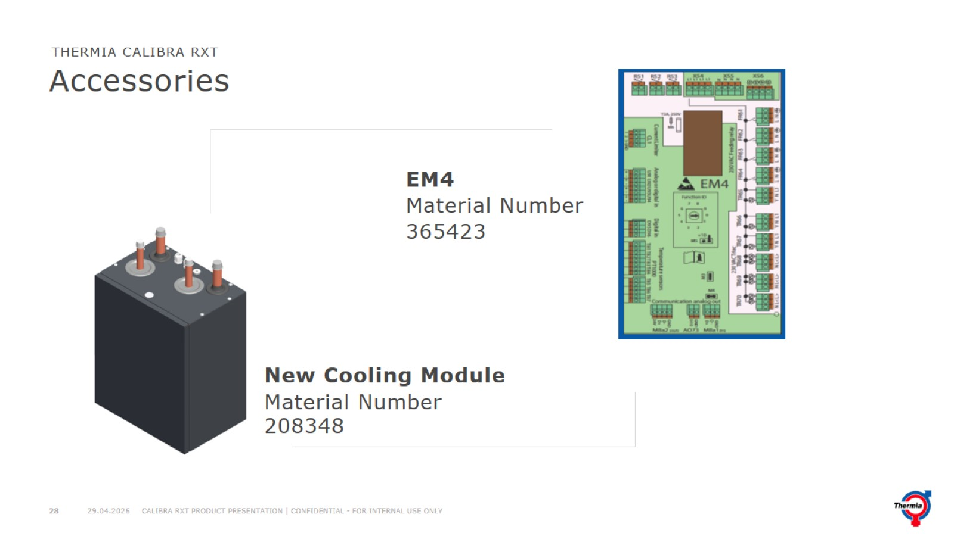
Accessories

Slide 29
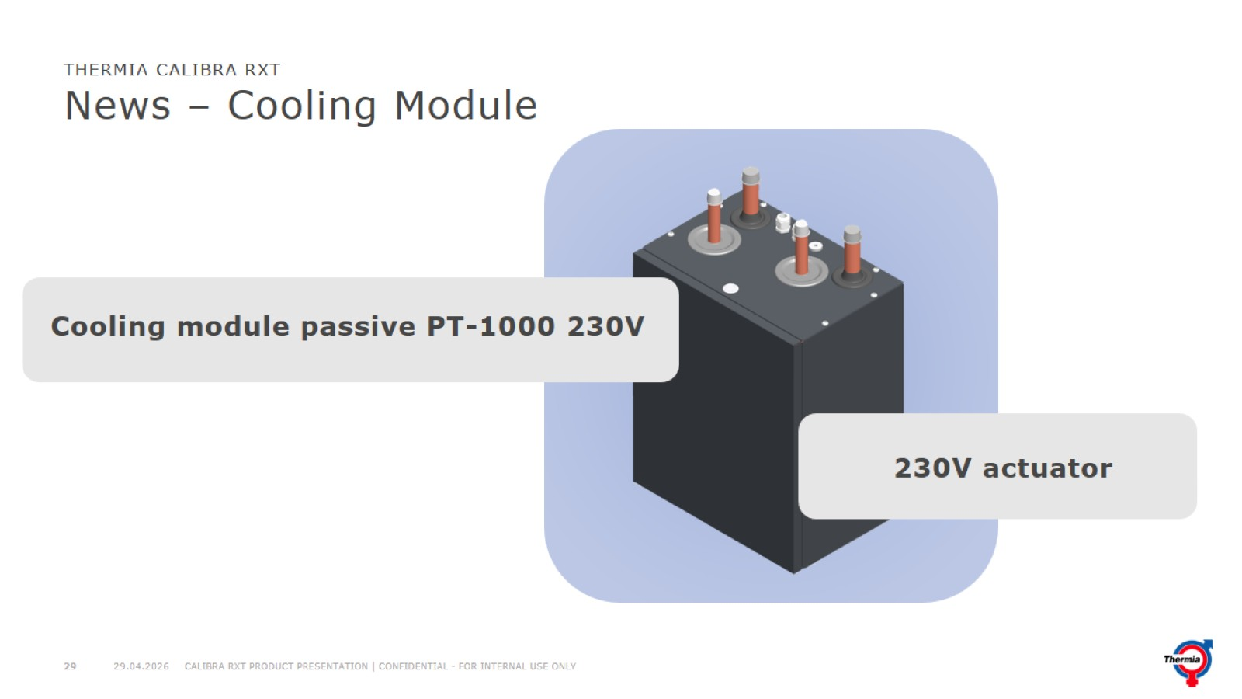
News – Cooling Module

Slide 30
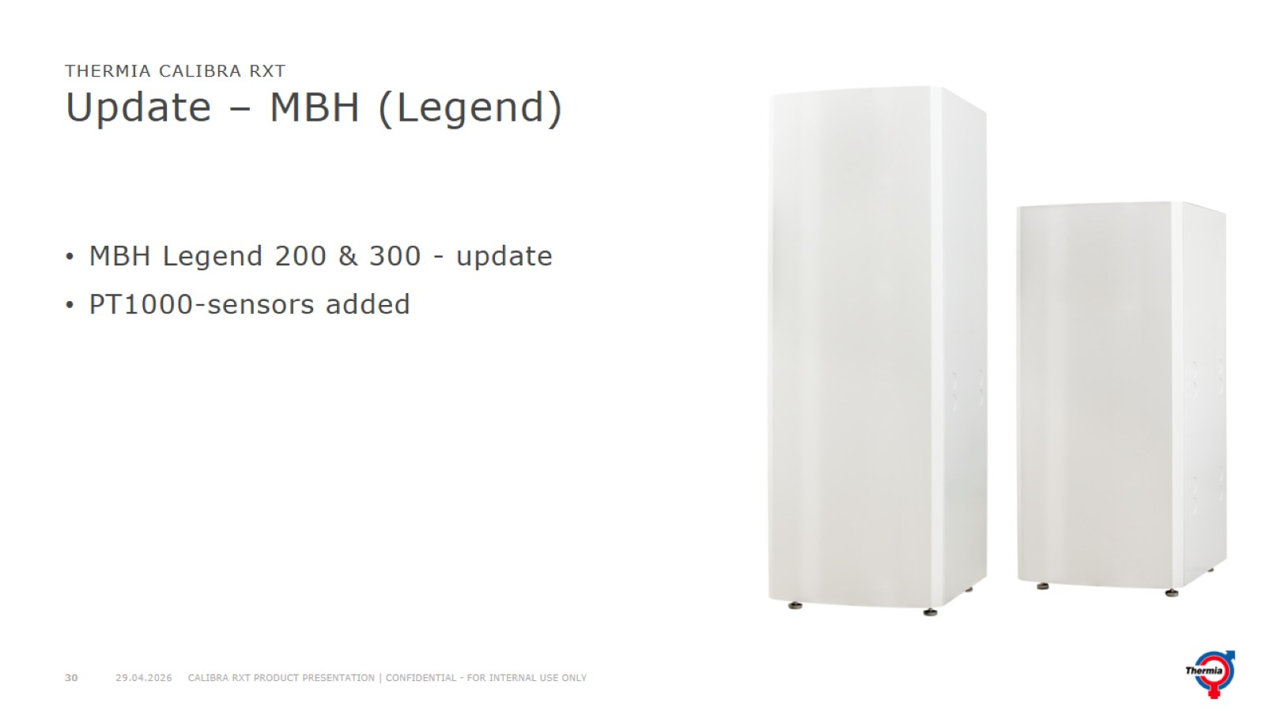
Update – MBH (Legend)

Slide 31
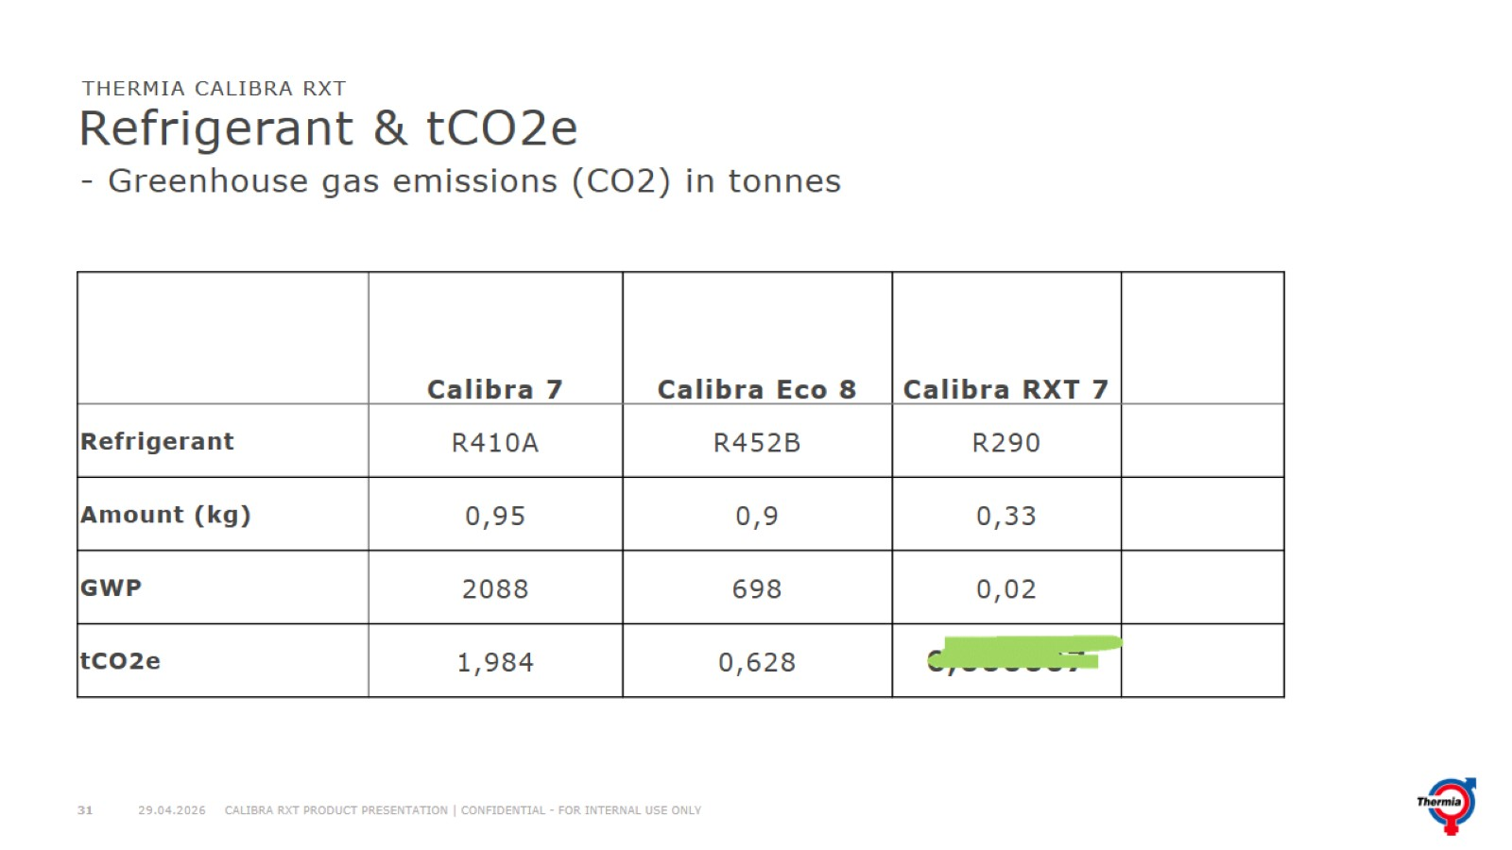
Refrigerant & tCO2e

Slide 32
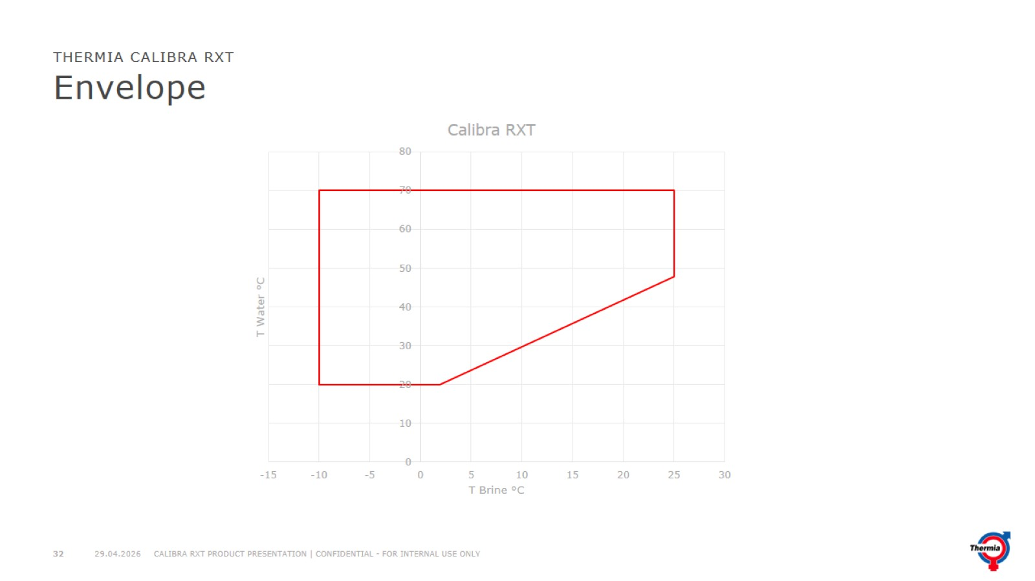
Envelope

Slide 33
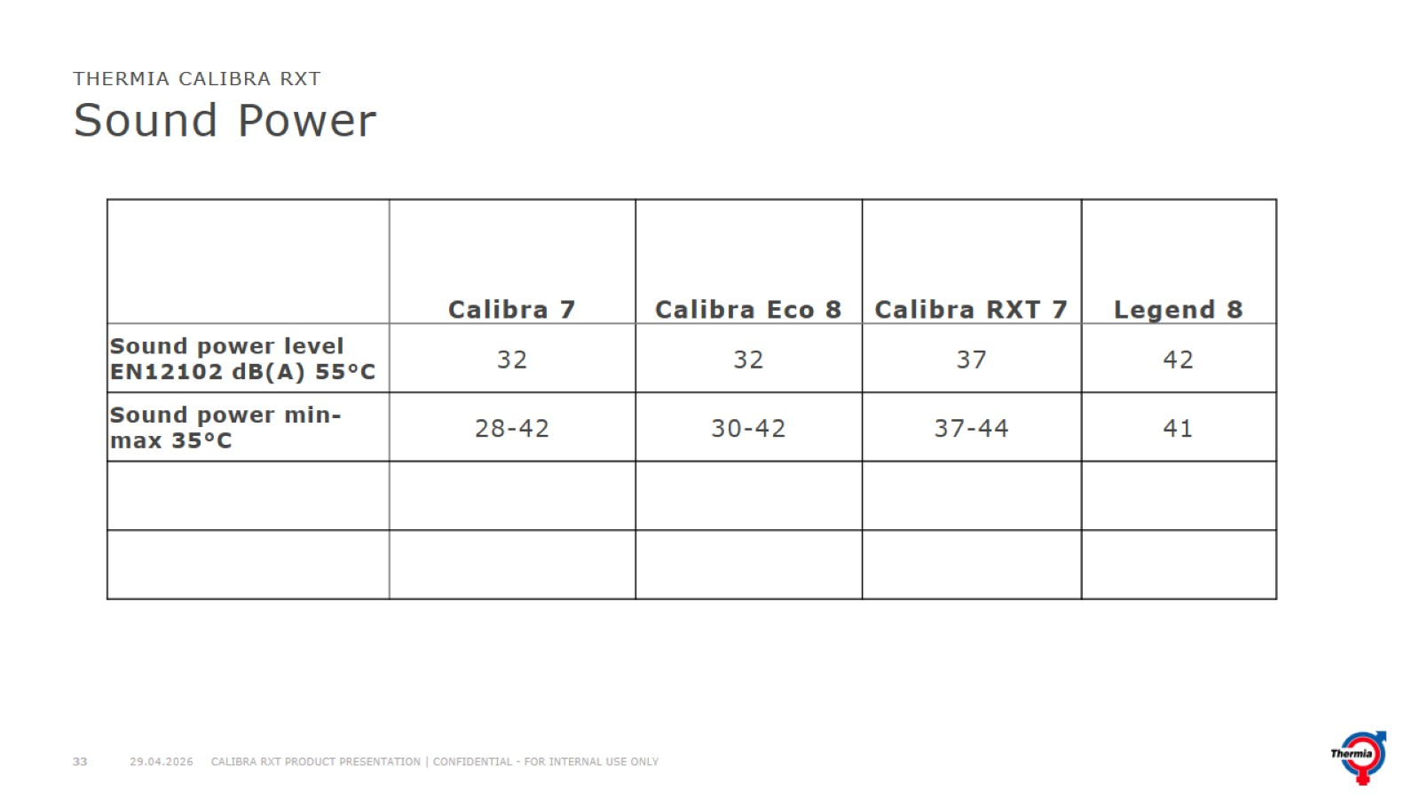
Sound Power

Slide 34
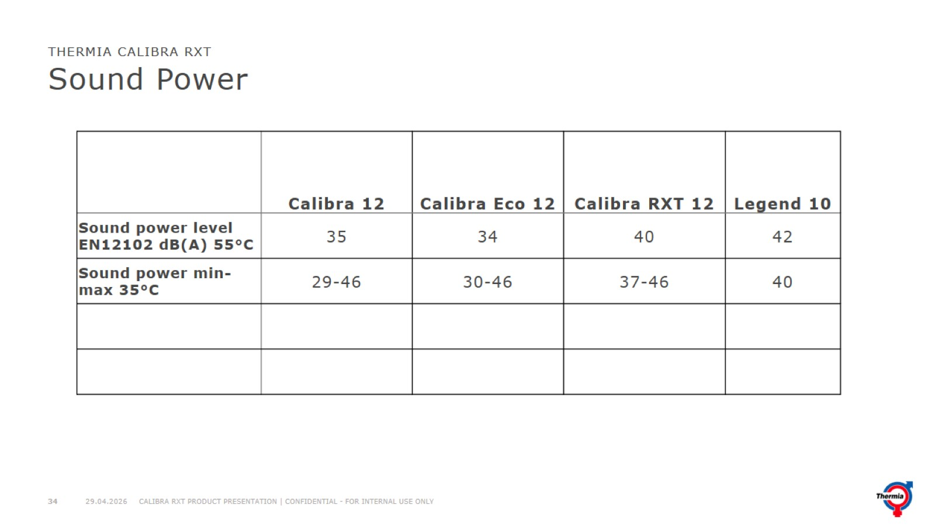
Sound Power

Slide 35
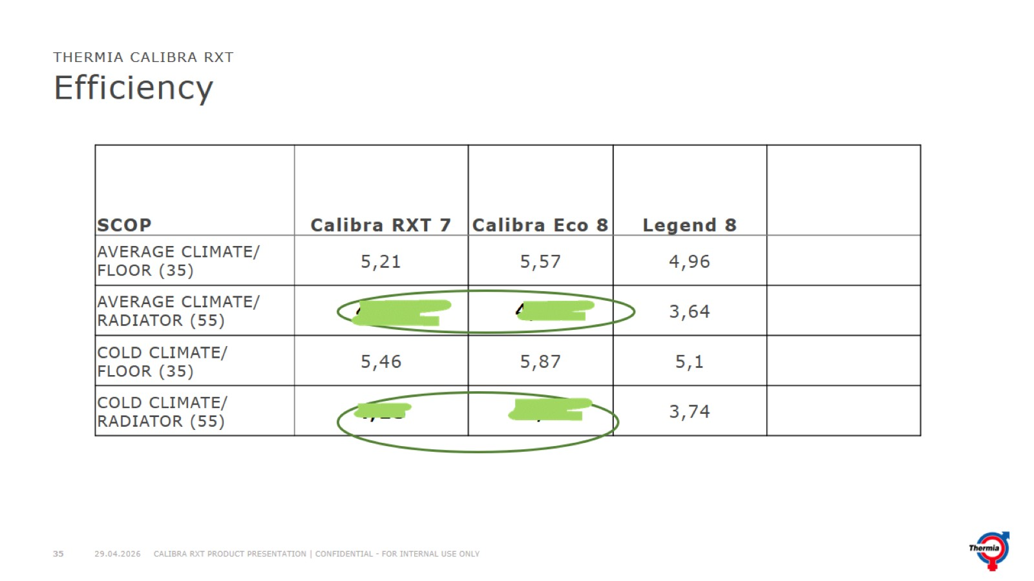
Efficiency

Slide 36
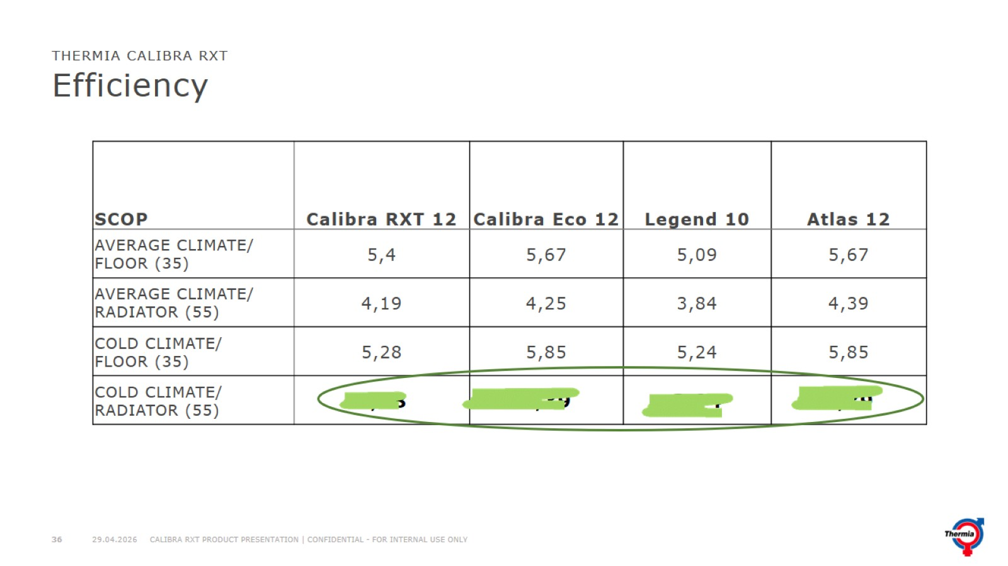
Efficiency

Slide 37
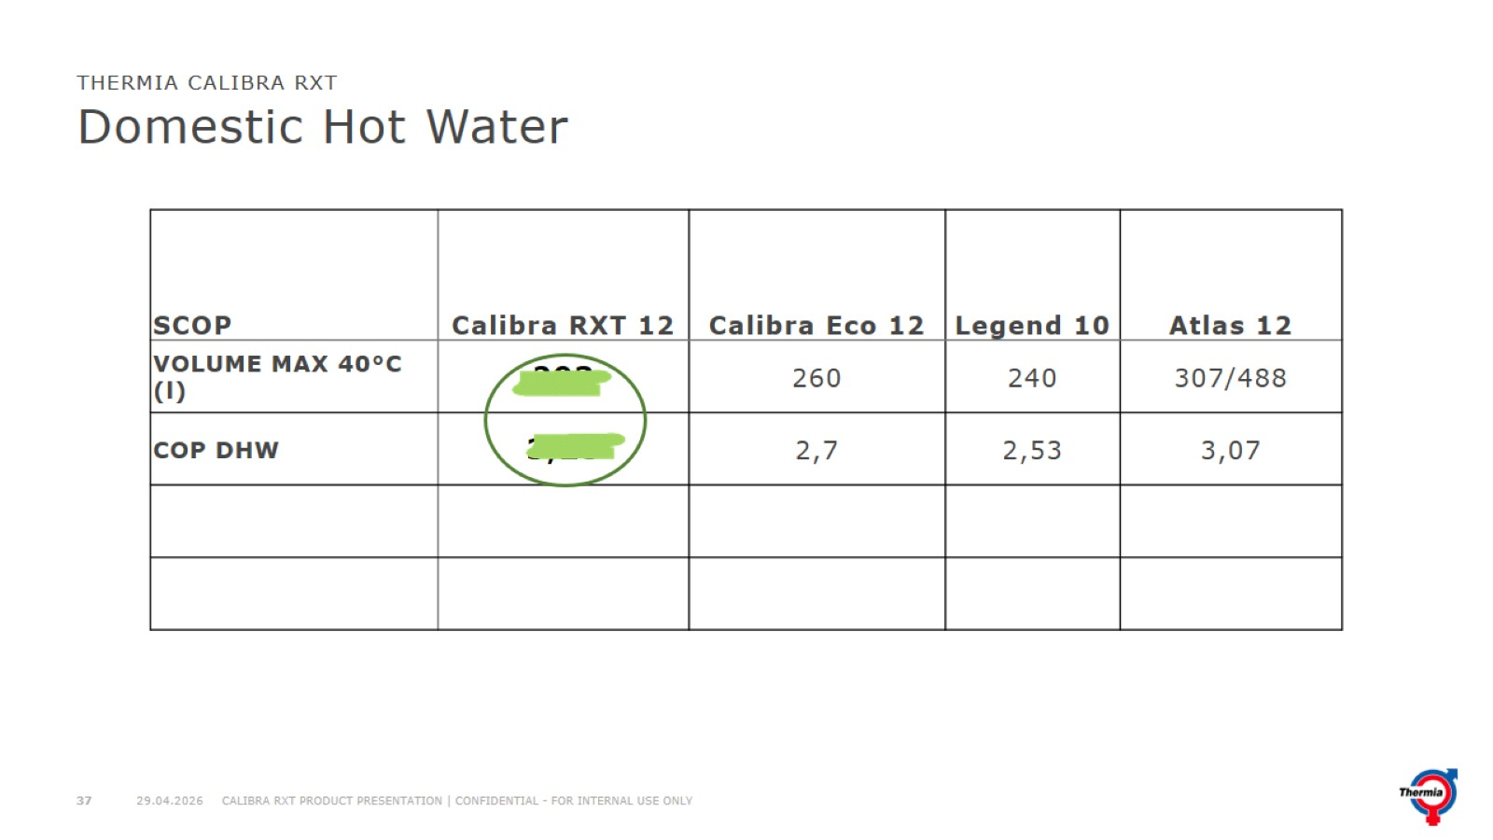
Domestic Hot Water

Slide 38
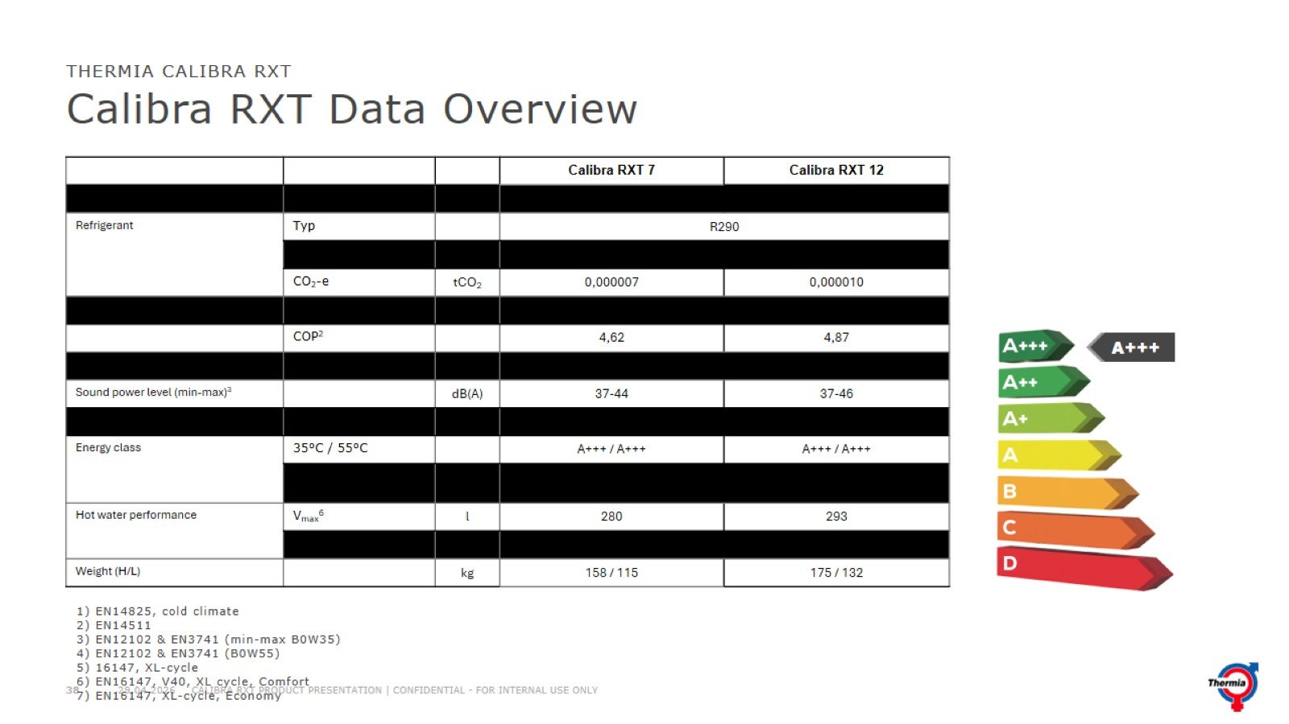
Calibra RXT Data Overview

Slide 39
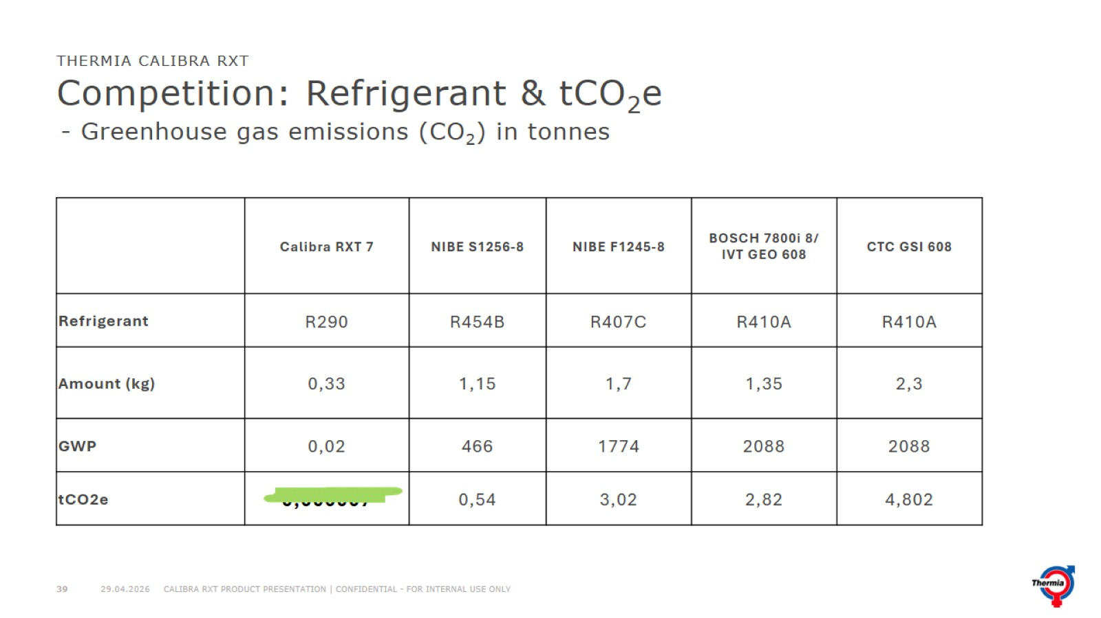
Competition: Refrigerant & tCO₂e

Slide 40
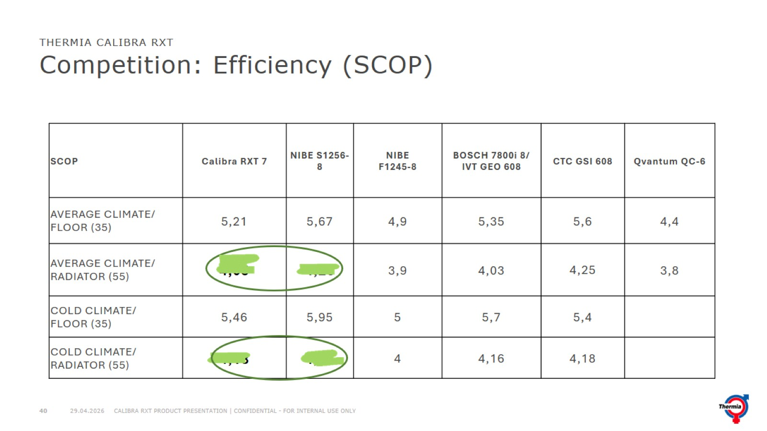
Competition: Efficiency (SCOP)

Slide 41
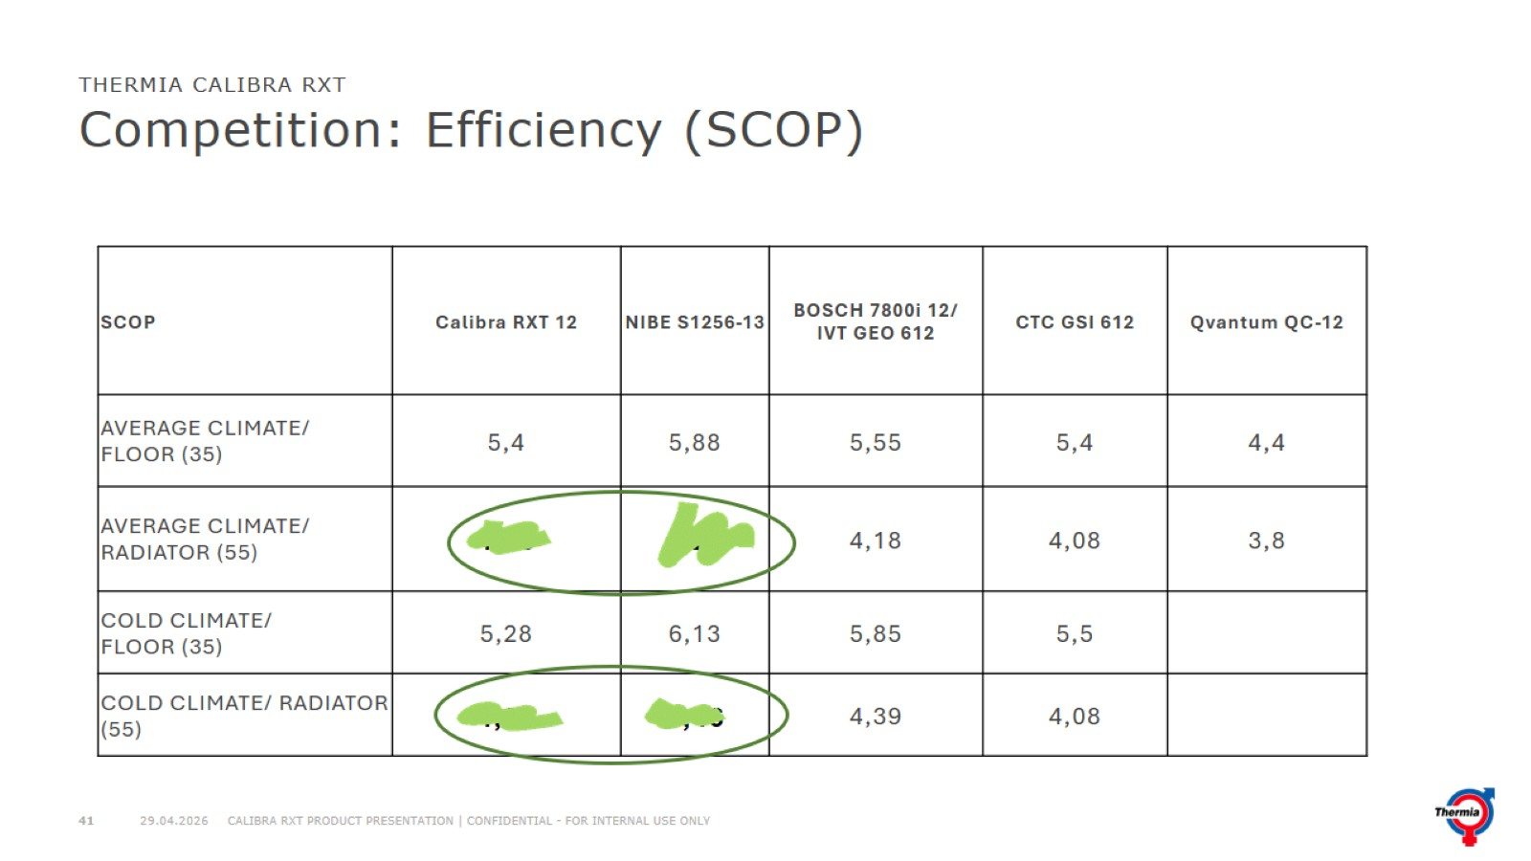
Competition: Efficiency (SCOP)

Slide 42
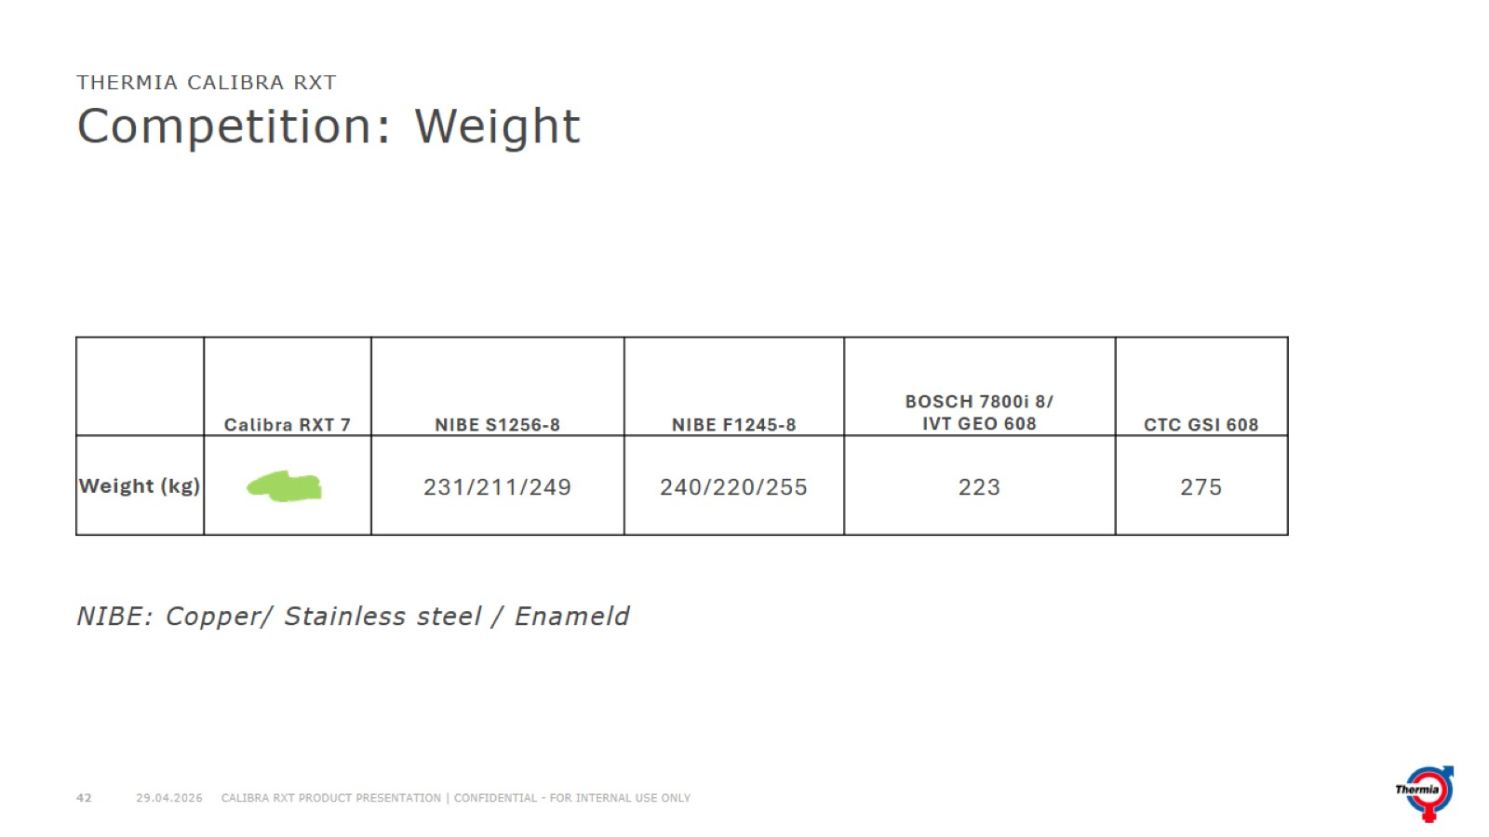
Competition: Weight

Slide 43
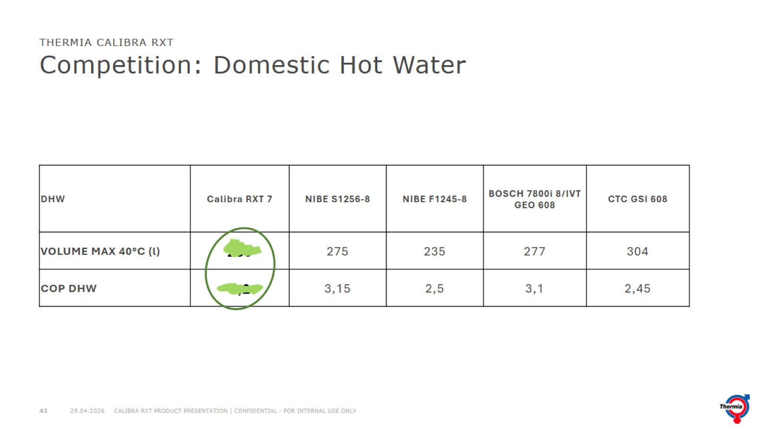
Competition: Domestic Hot Water

Slide 44
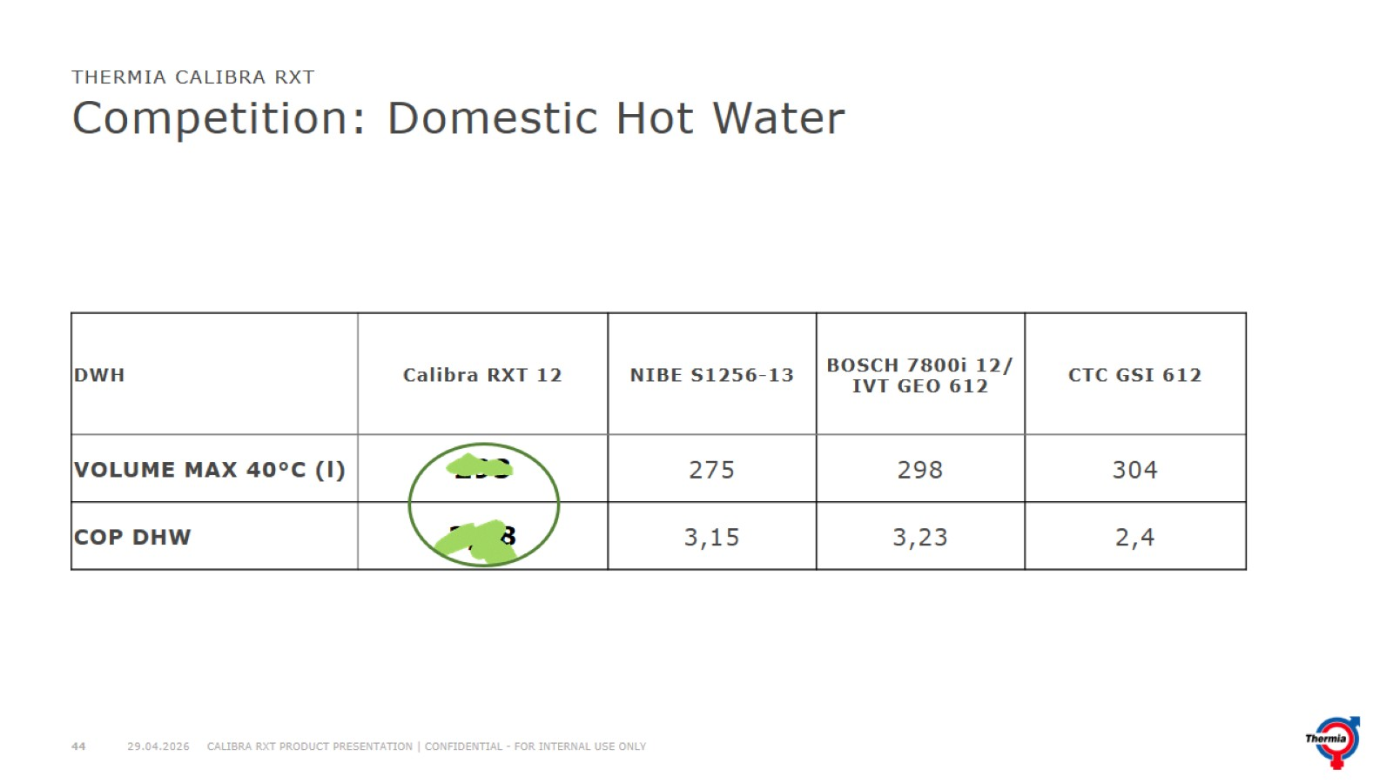
Competition: Domestic Hot Water

Slide 45
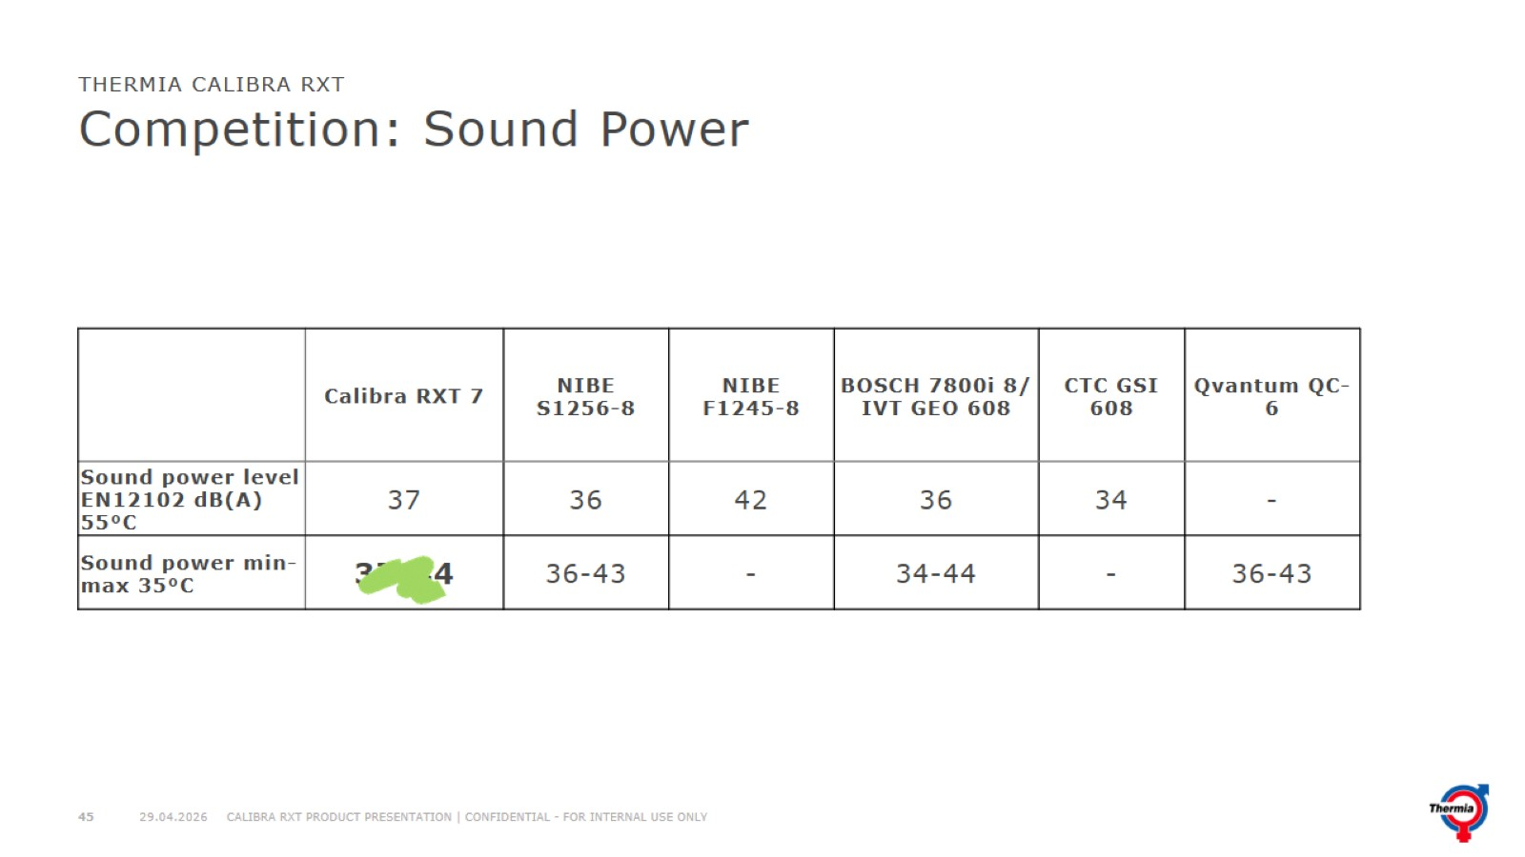
Competition: Sound Power

Slide 46
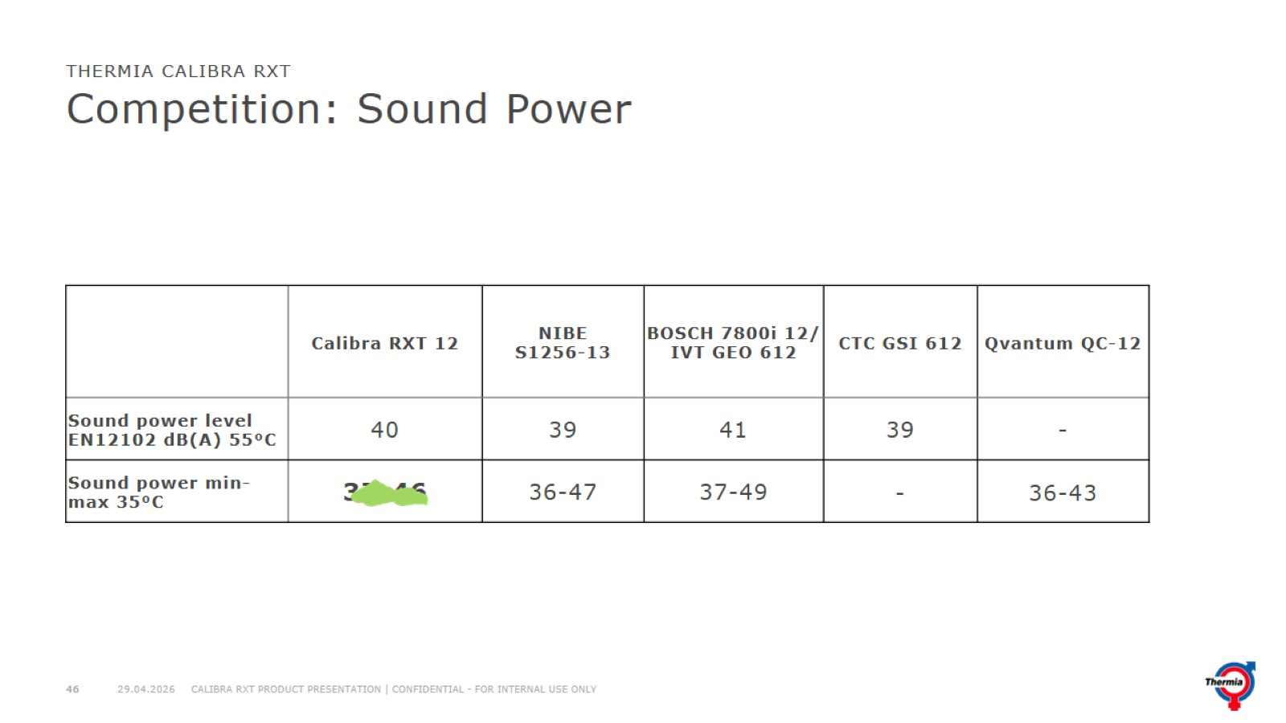
Competition: Sound Power

Slide 47
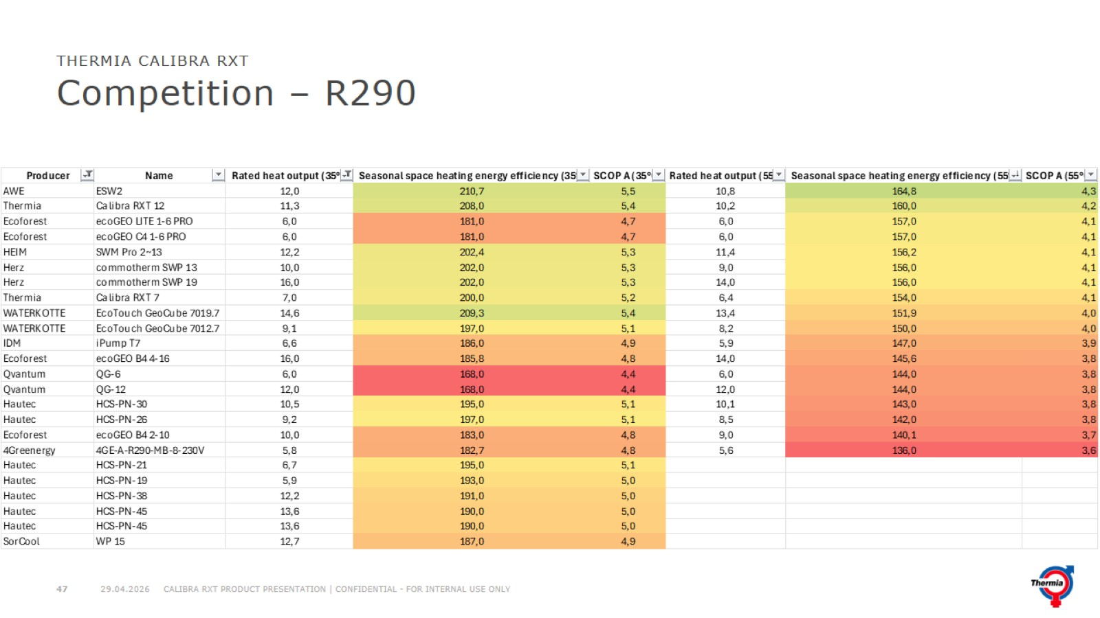
Competition – R290

Slide 48
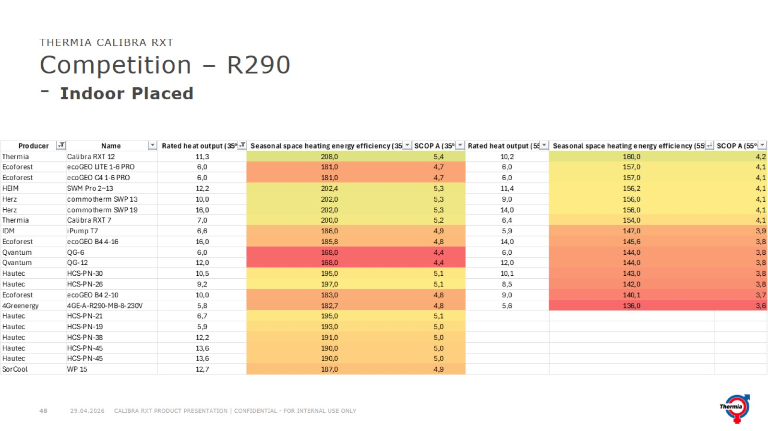
Competition – R290
- Indoor Placed

Slide 49
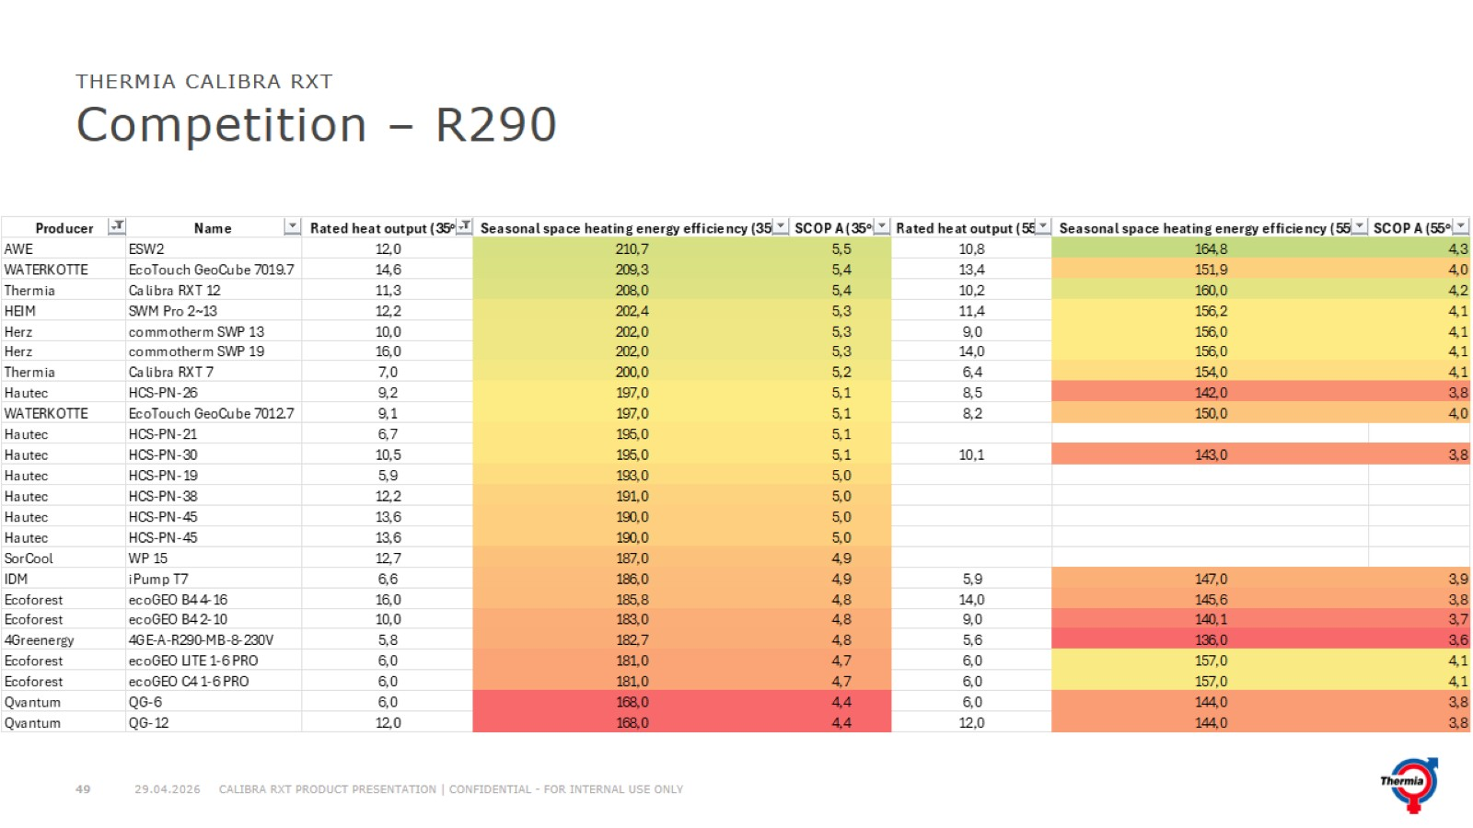
Competition – R290

Slide 50
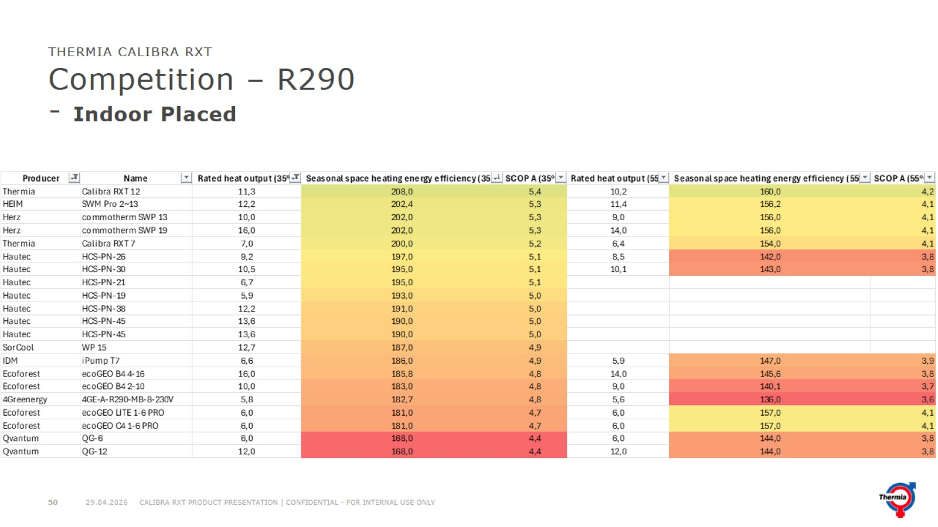
Competition – R290
- Indoor Placed

Slide 51
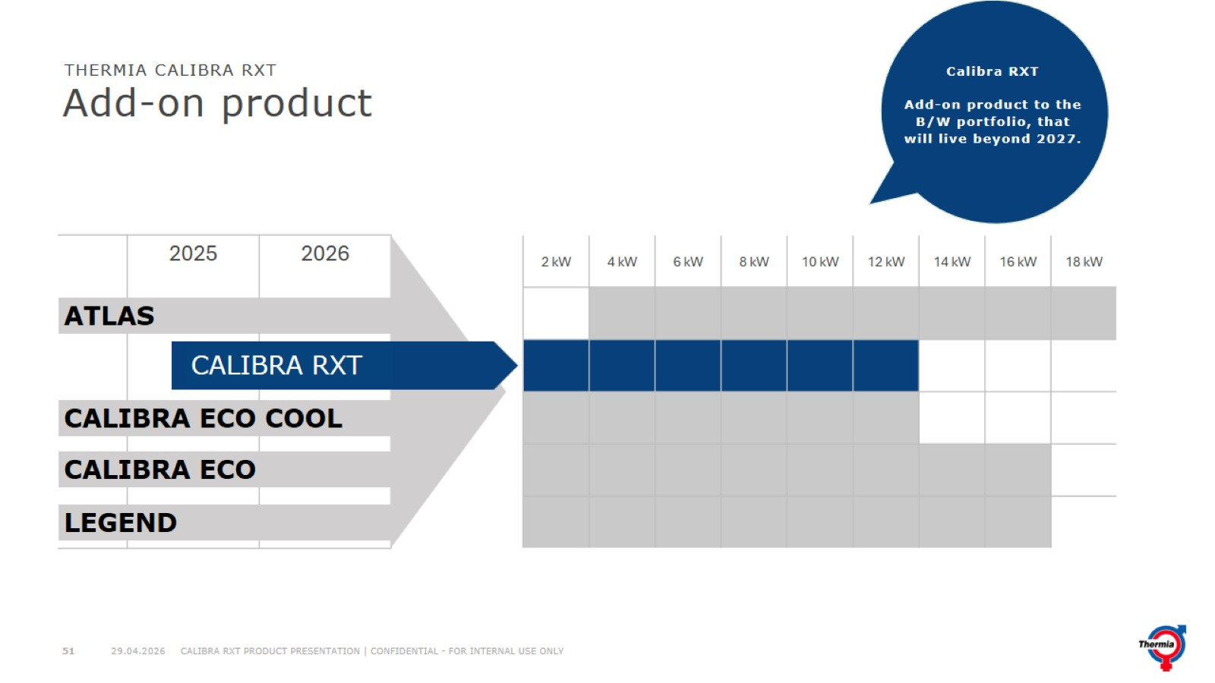
Add-on product

Slide 52
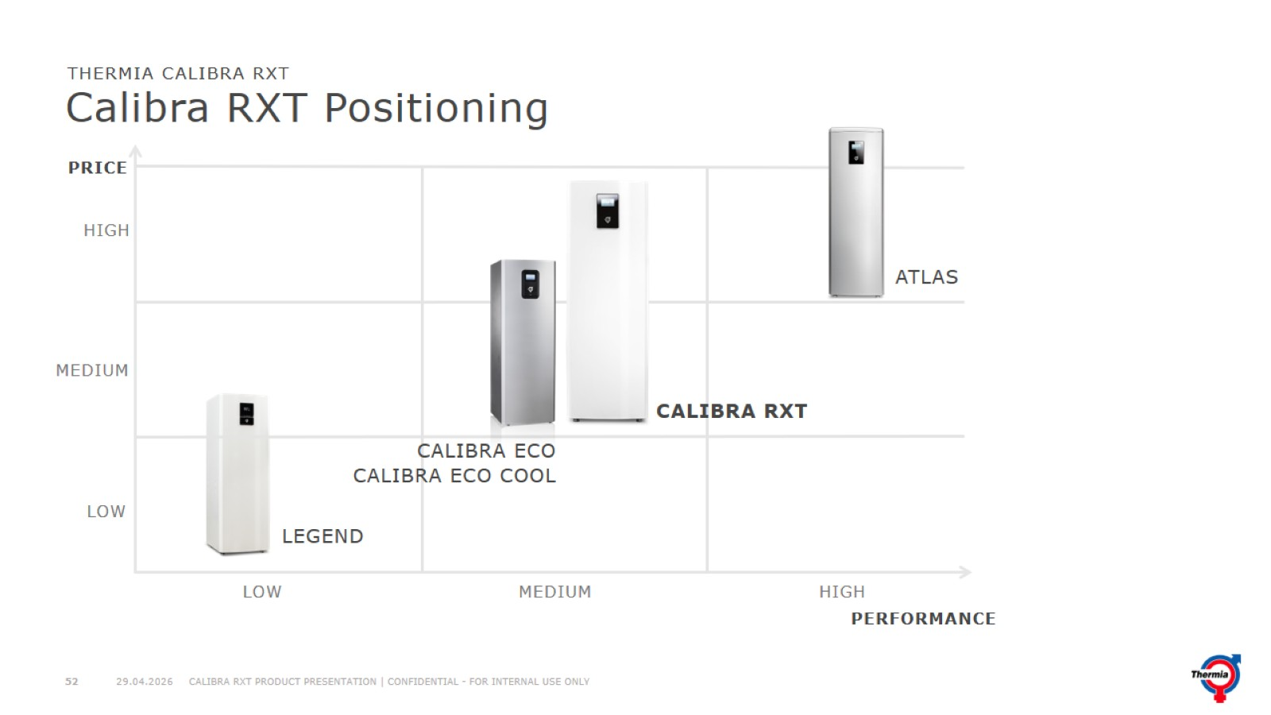
Calibra RXT Positioning

Slide 53
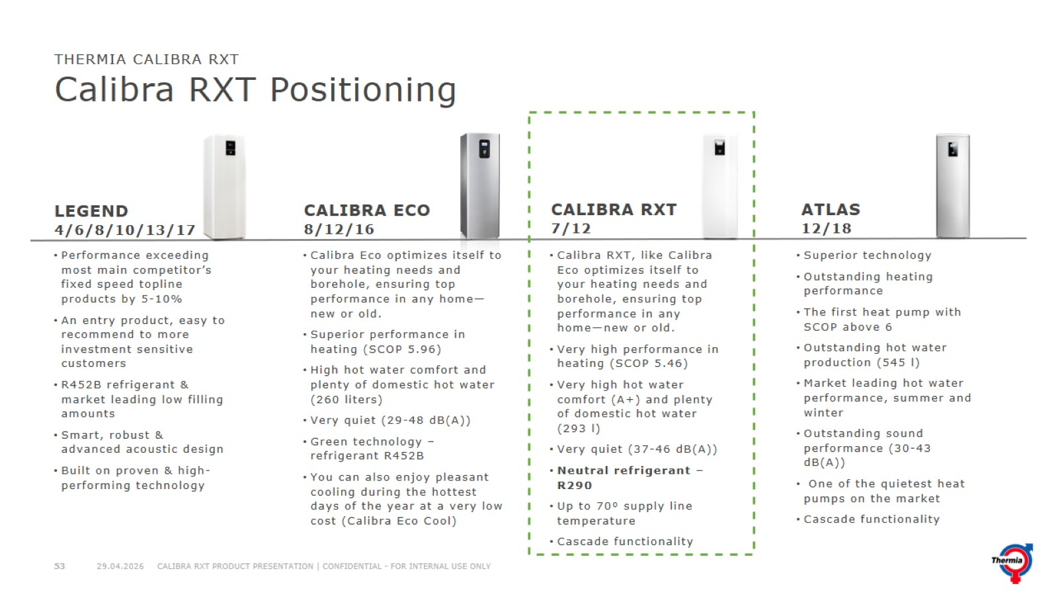
Calibra RXT Positioning

Slide 54

Target Applications Calibra RXT

Slide 55

Calibra RXT

